Slide 1
Young Risers Pre-School

Slide 2
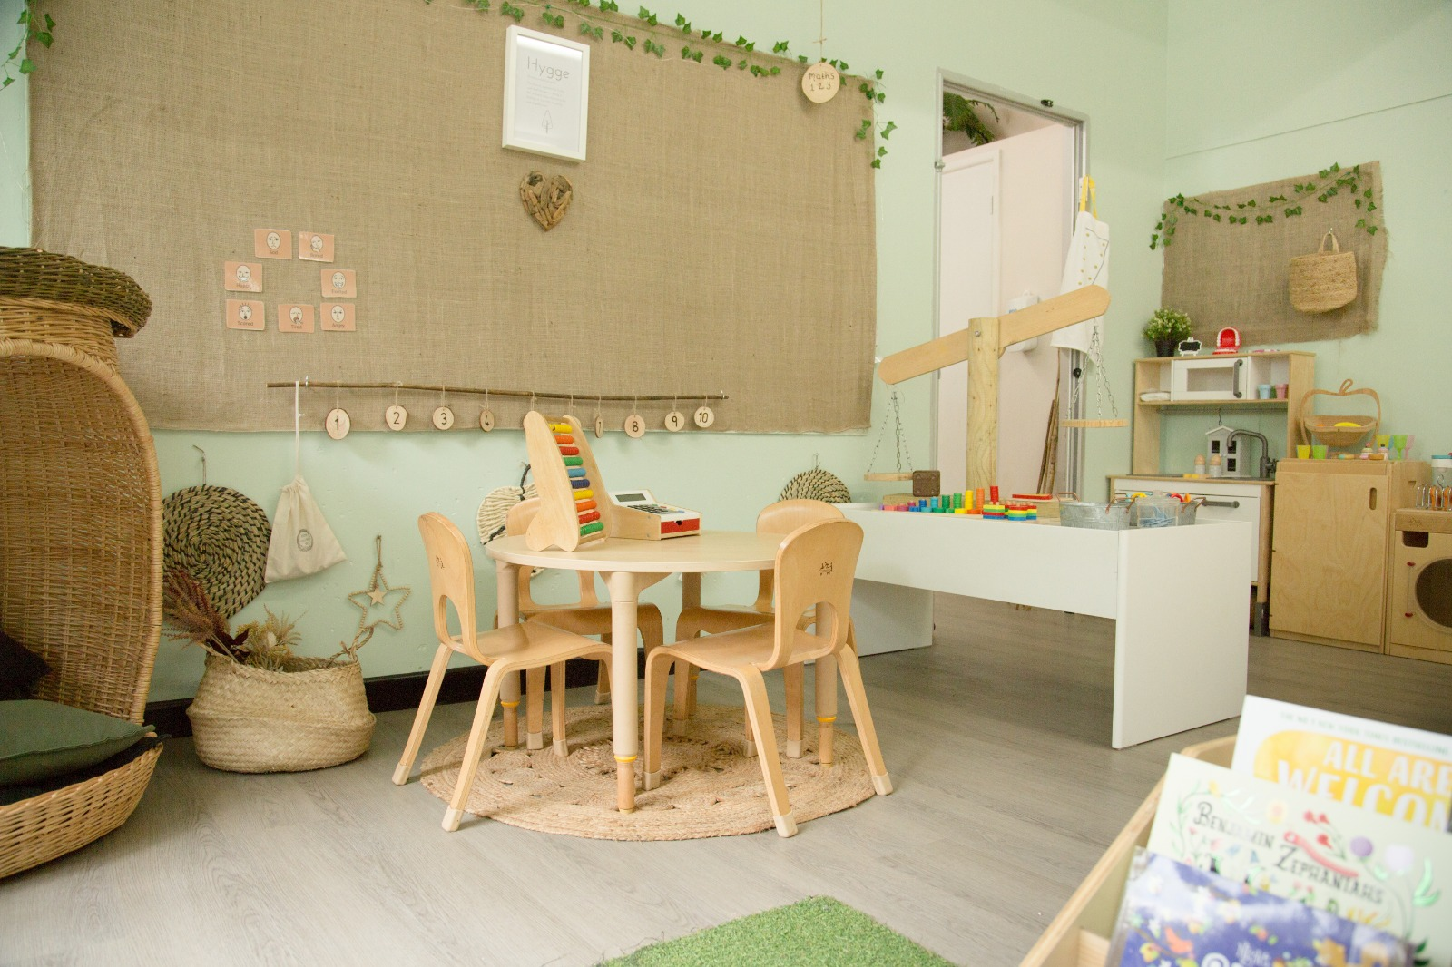
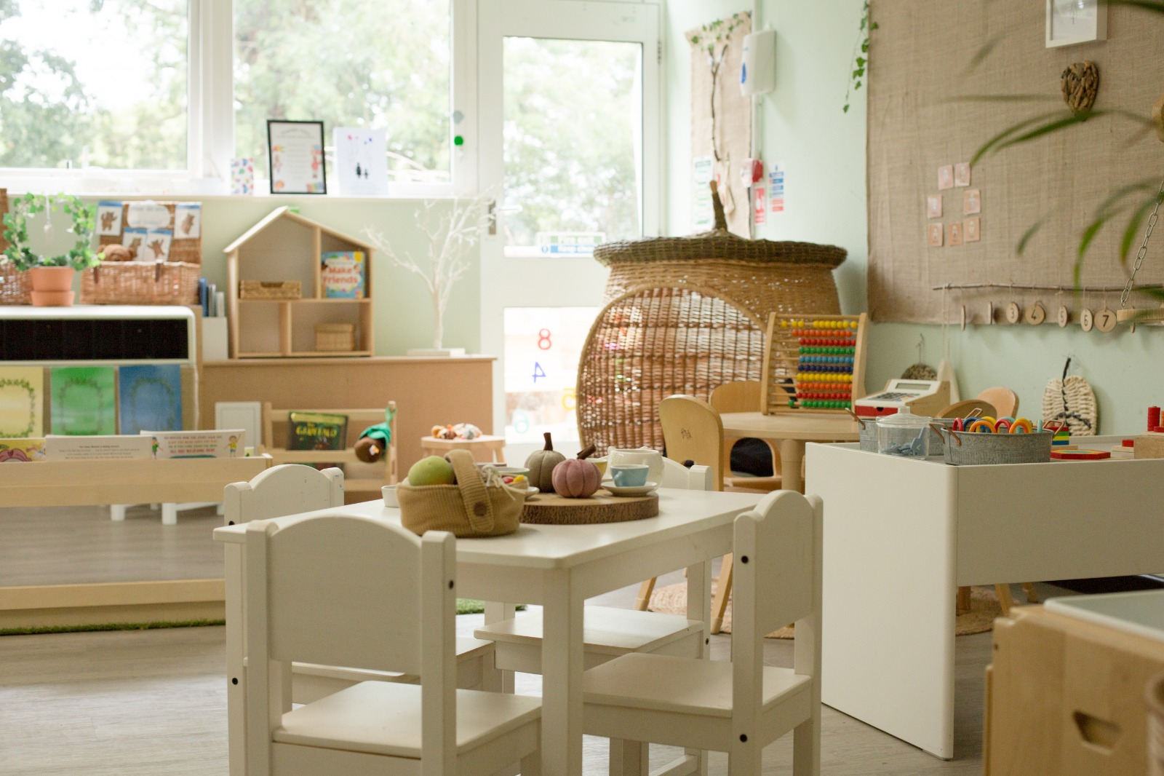
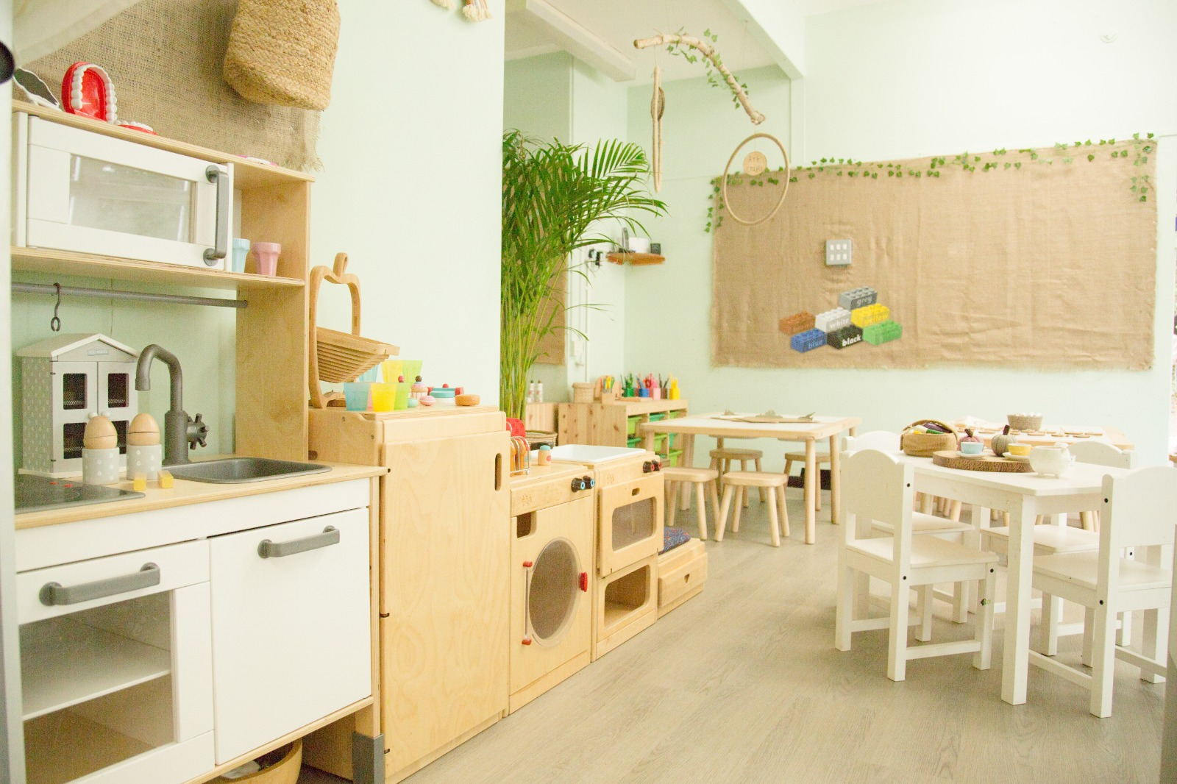
Welcome to Young Risers Pre-School
Young Risers was established in 1972. Young Risers Pre-School is a non profit community pre-school offering early years education for children aged 2-5 years. The pre-school is run by an elected parent committee and is staffed by a team of qualified Early Years professionals dedicated in providing a safe and caring environment for your child to play and learn.
We are based in the grounds of Istead Rise Primary School.

Slide 3
Opening Times
The pre-school is open from 9am until 3pm Monday to Friday. The day is divided into three different sessions, morning session is 9am-12pm and the afternoon session is 12pm-3pm or we offer an all day session. The afternoon session starts with lunch and your child will need to bring their own packed lunch. We recommend that children attend a minimum of two sessions per week to aid the settling in process. We can cater for up to 24 children per session.
Staffing
The staff at Young Risers Pre-school are all qualified to Early Years Level 3 and paediatric first aid trained. The management team are also trained in Safeguarding and Special Educational Needs and they are also responsible for the day to day running of the pre-school, this includes ensuring that the child to staff ratios are met:-
Children aged 2 = 1 staff to every 4 children
Children aged 3+ = 1 staff to every 8 children
At Young Risers we always have more staff than the required ratio
Staff also attend regular training to ensure that their knowledge and understanding is up to date.

Slide 4
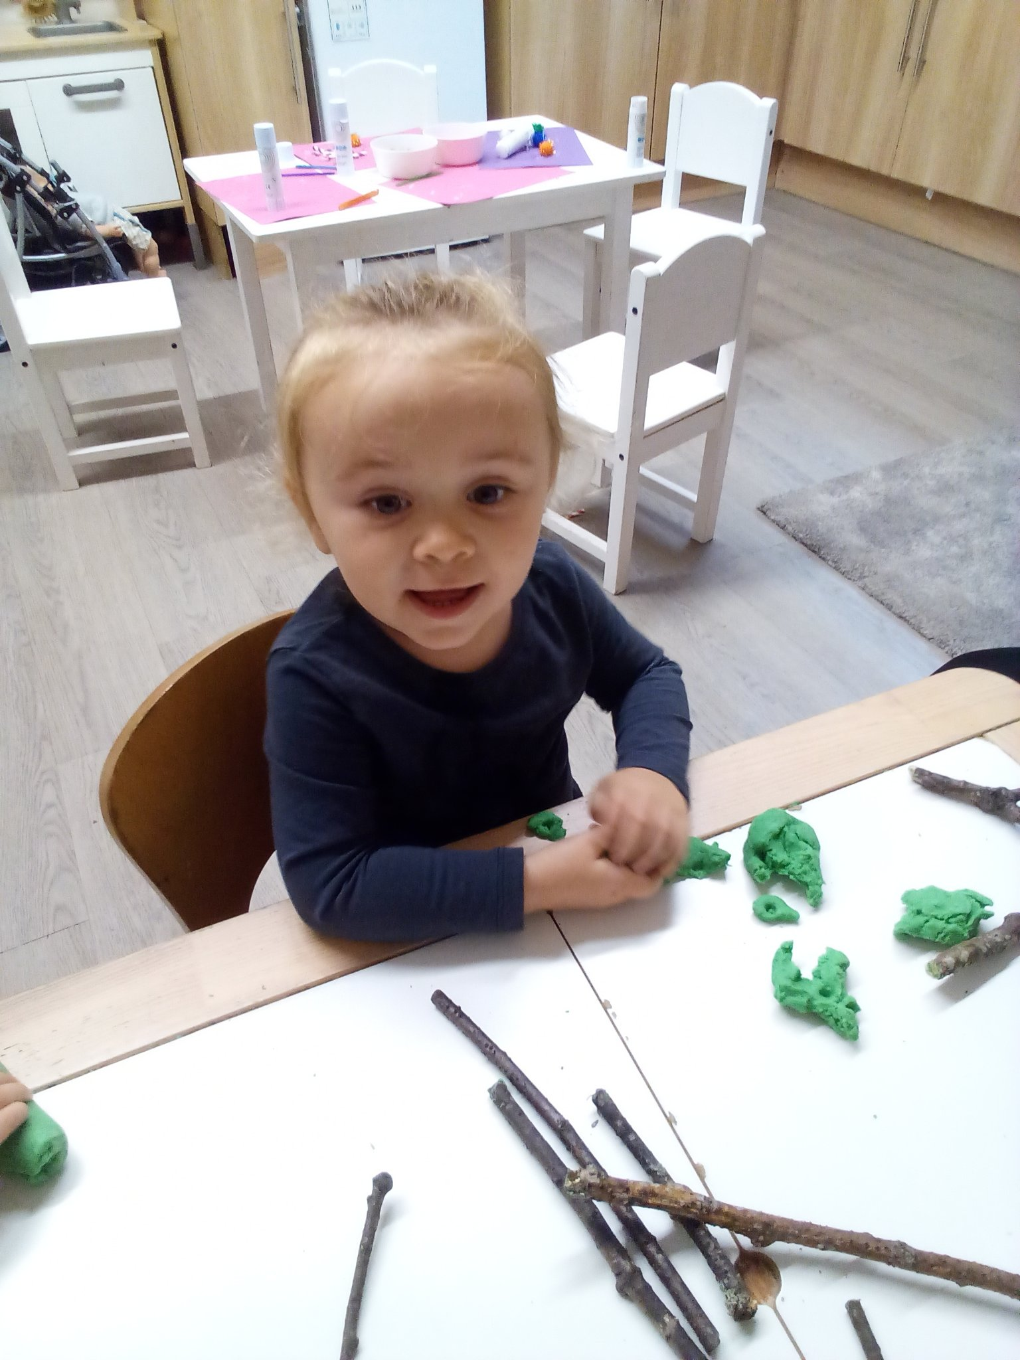
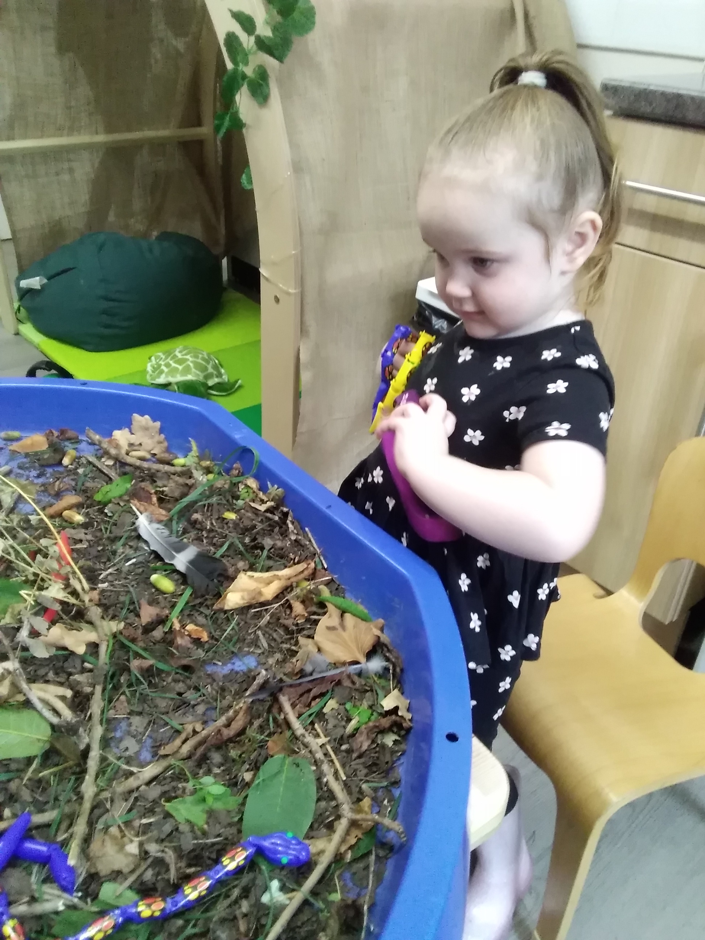
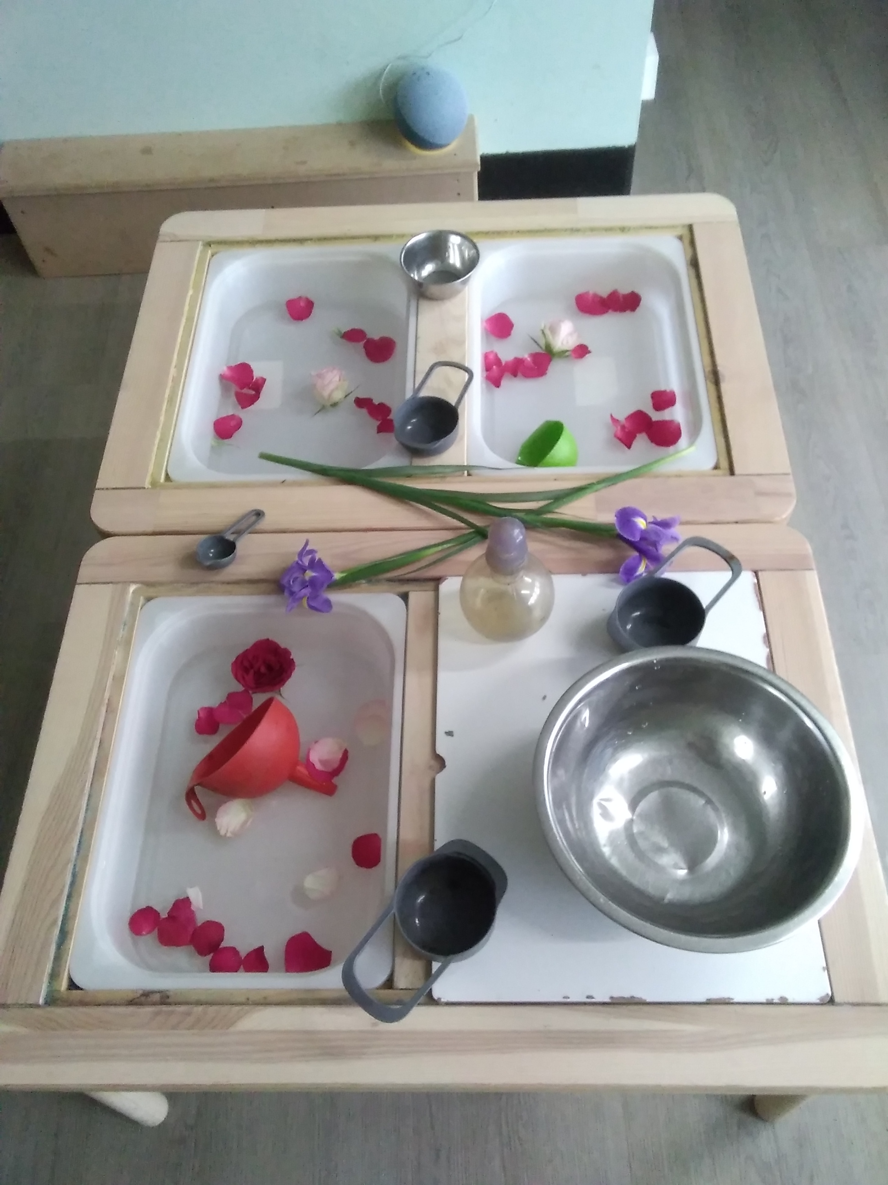
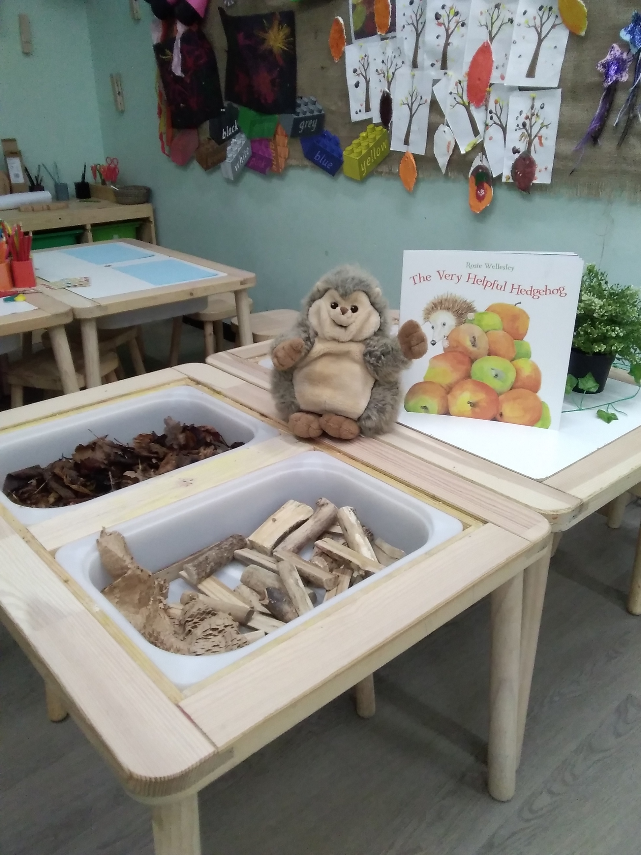
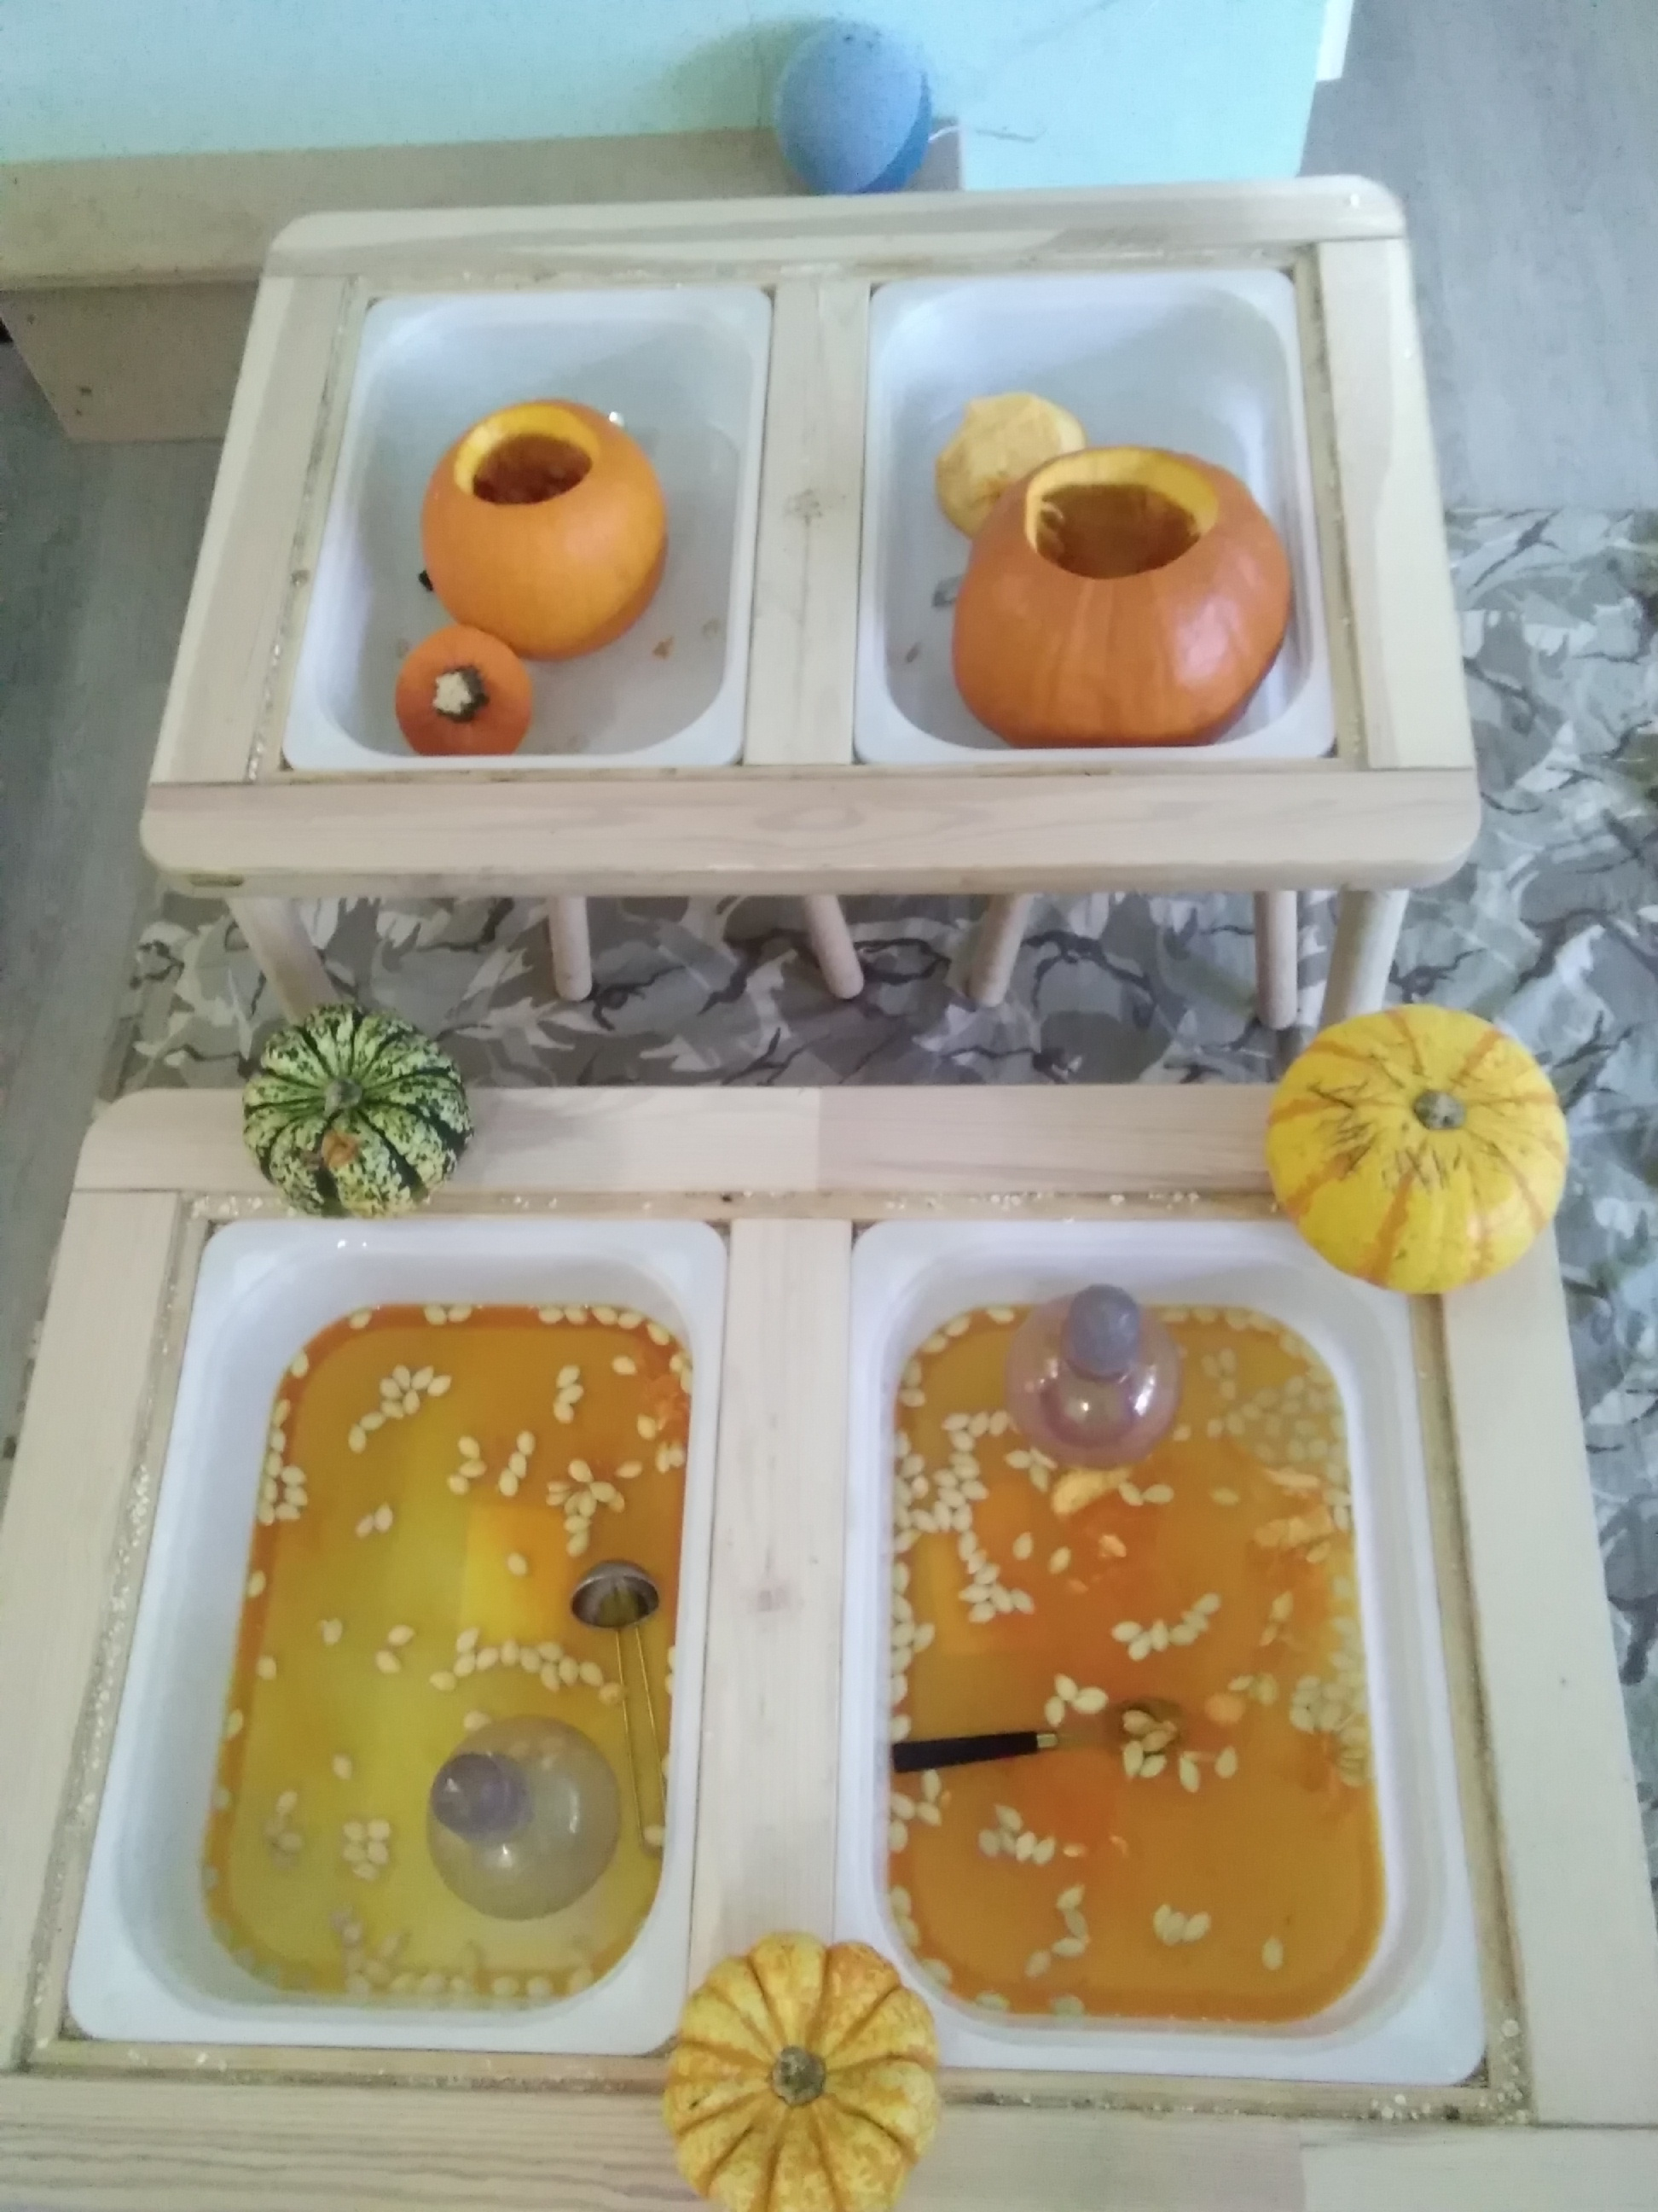
Hygge Accredited Pre-school
Young Risers is a Hygge accredited pre-school, what is Hygge I hear you ask?
Hygee – pronounced (hue-gah)
The Danish approach to living well that focuses on being in the moment and embracing the feelings of warmth, simplicity and togetherness.
We believe that you should live in the moment and enjoy the nature around you. We often bring things from nature inside to our setting for the children to explore.

Slide 5
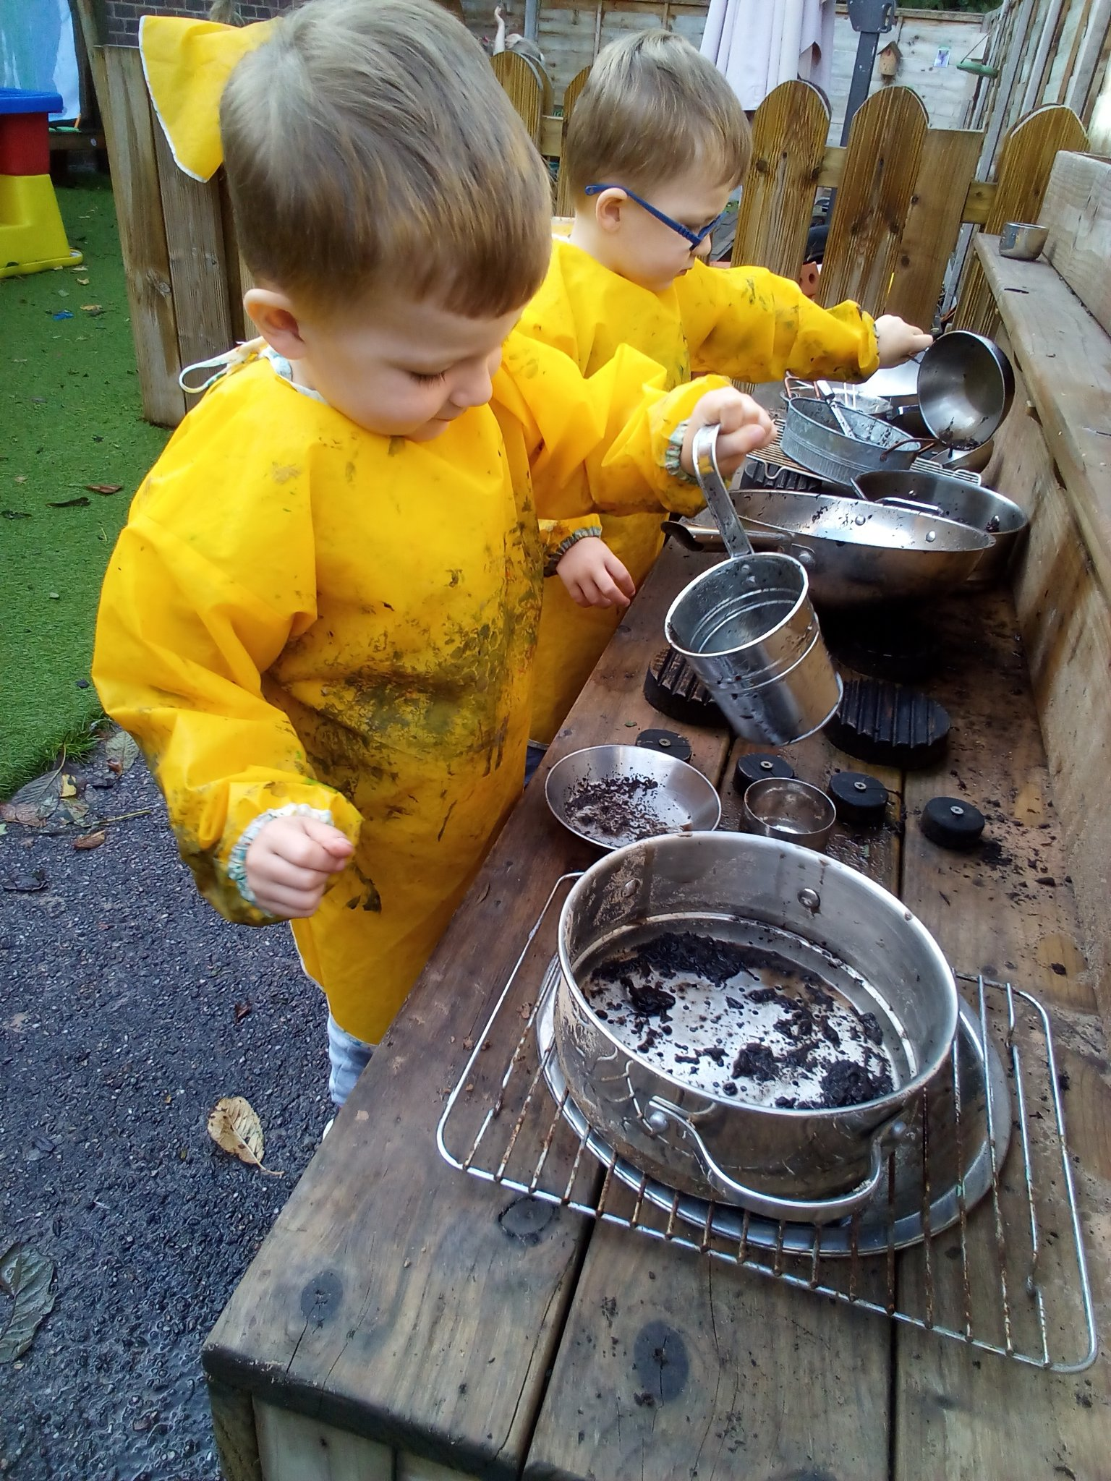
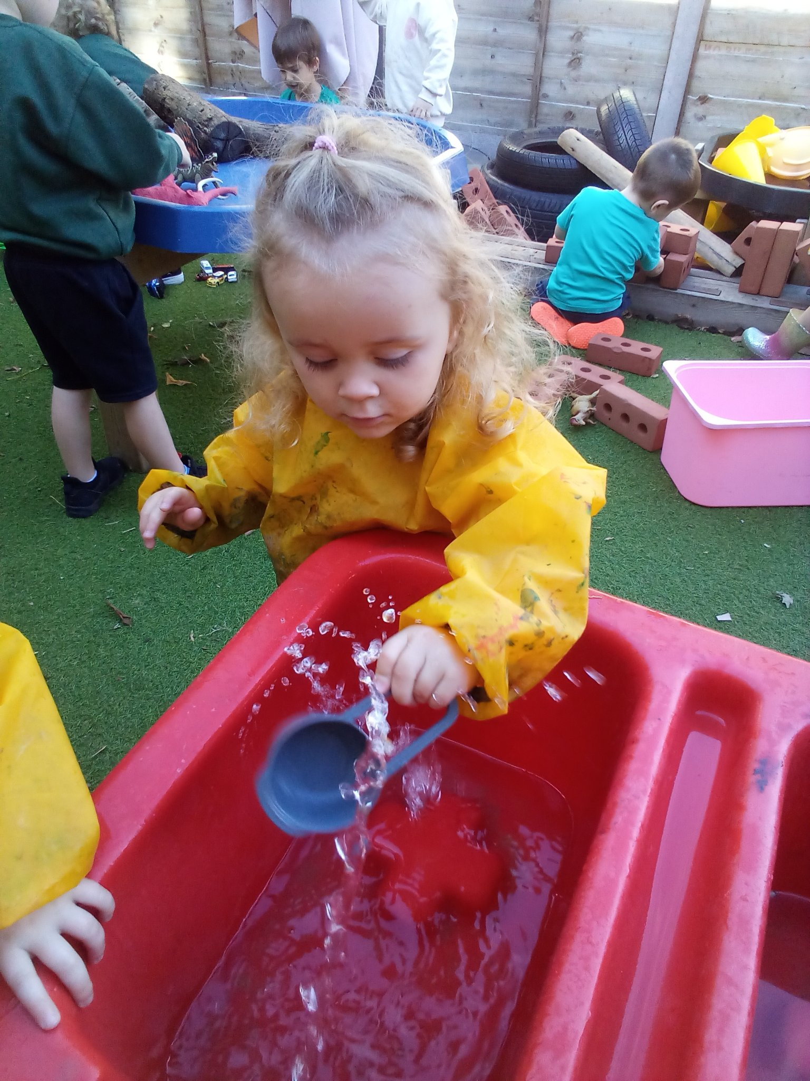
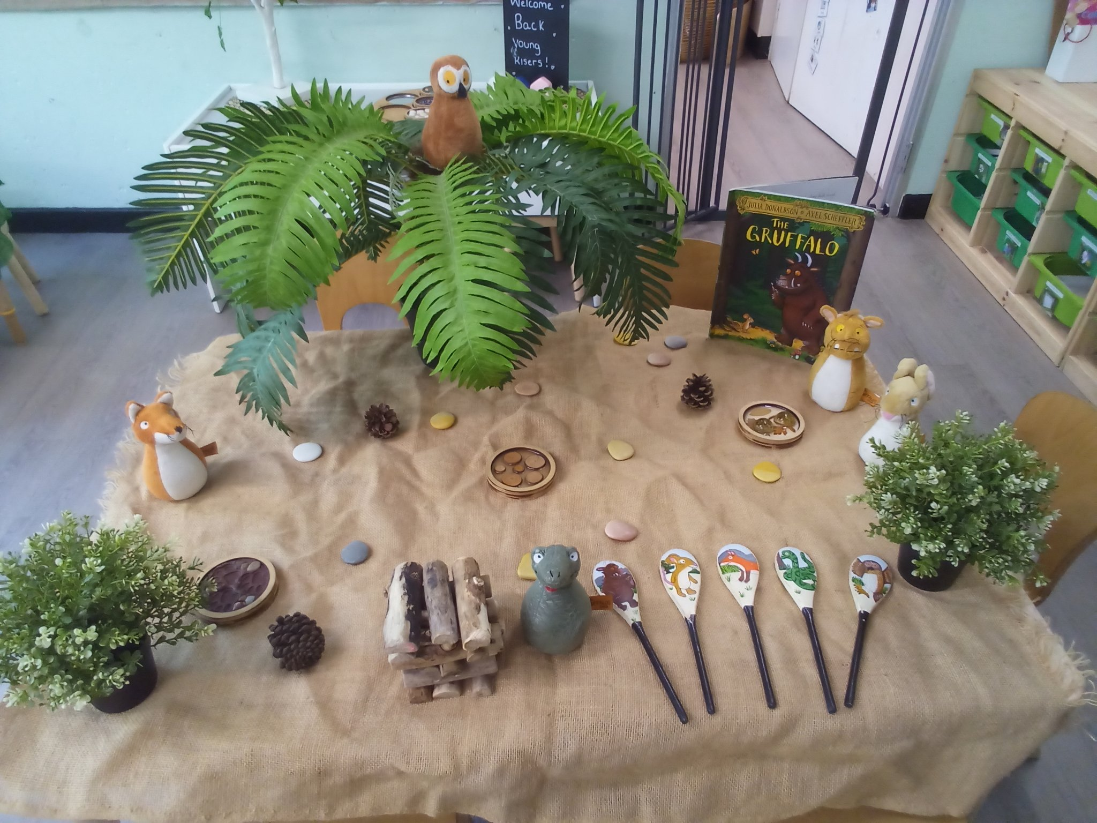
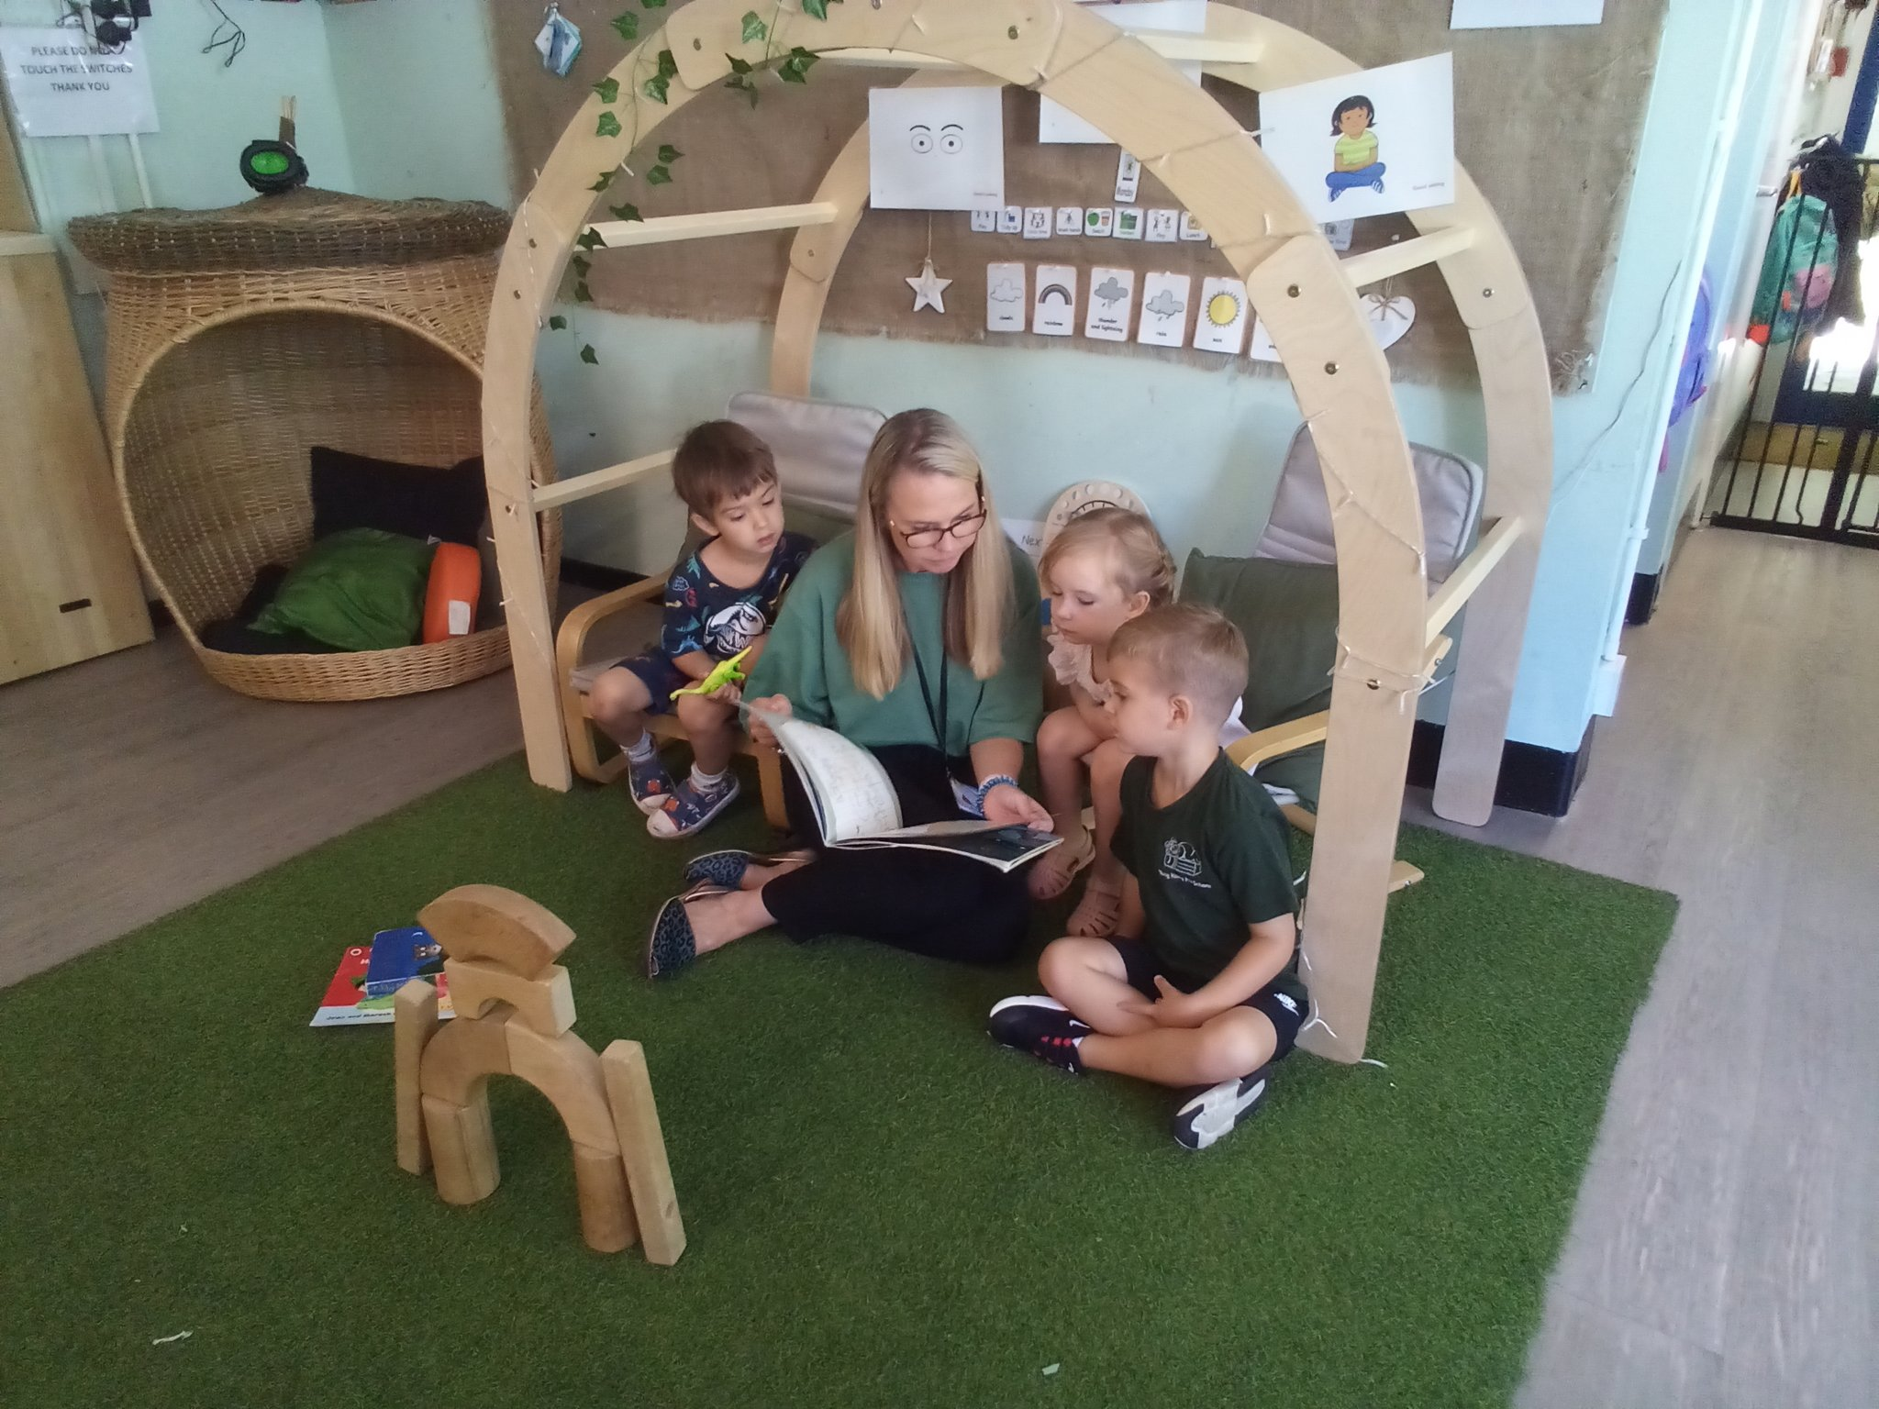
Key Person and First day at Pre-School
When your child starts pre-school, they will be assigned a key person. The key person will work closely with you and your child to make sure that their transition into pre-school is as smooth as possible and this will include a couple of settling in sessions. On your settle sessions you will be invited to stay and play with your child, during the session your child’s key person will go through the Tapestry system and any other paperwork.
When your child start’s they will be given a named peg for their belongings, please ensure that your child has a named water bottle, a named bag with a spare change of clothes which is also named.
Your child’s key person will also be responsible for observing your child through play in the setting and will then plan for your child ensuring that their individual interests and needs are met. After two weeks of being in pre-school we will complete a baseline assessment in line with the EYFS.

Slide 6
Our Aims and the curriculum
We believe that the child’s wellbeing and development are paramount. We treat each and every child with respect and as an individual, with equal opportunity regardless of race, gender, physical ability, mental ability or cultural background.
It is our aim to treat each child as an individual, and to encourage each child to develop, explore and expand their knowledge at their own learning pace. Children will learn through their play, through physical activity and through their senses, so when planning and providing activities we take this into consideration, as well as planning for each individual child.
The statutory framework for the Early Years Foundation Stage (EYFS) sets the standards for promoting the learning, development and safety of children from birth to five years in Ofsted registered settings. The EYFS lays down the legal requirements that early years childcare providers must meet, including:-
Learning and development requirements: specific areas of learning and development which should shape the activities and experiences you offer.
Assessment requirements: how you measure children’s progress and feedback to parents or carers.
Safeguarding and welfare requirements: what you must do to keep child safe and promote their welfare.
There are seven areas of learning in the EYFS, three prime areas of learning and four specific areas or learning please see below:-

Slide 7
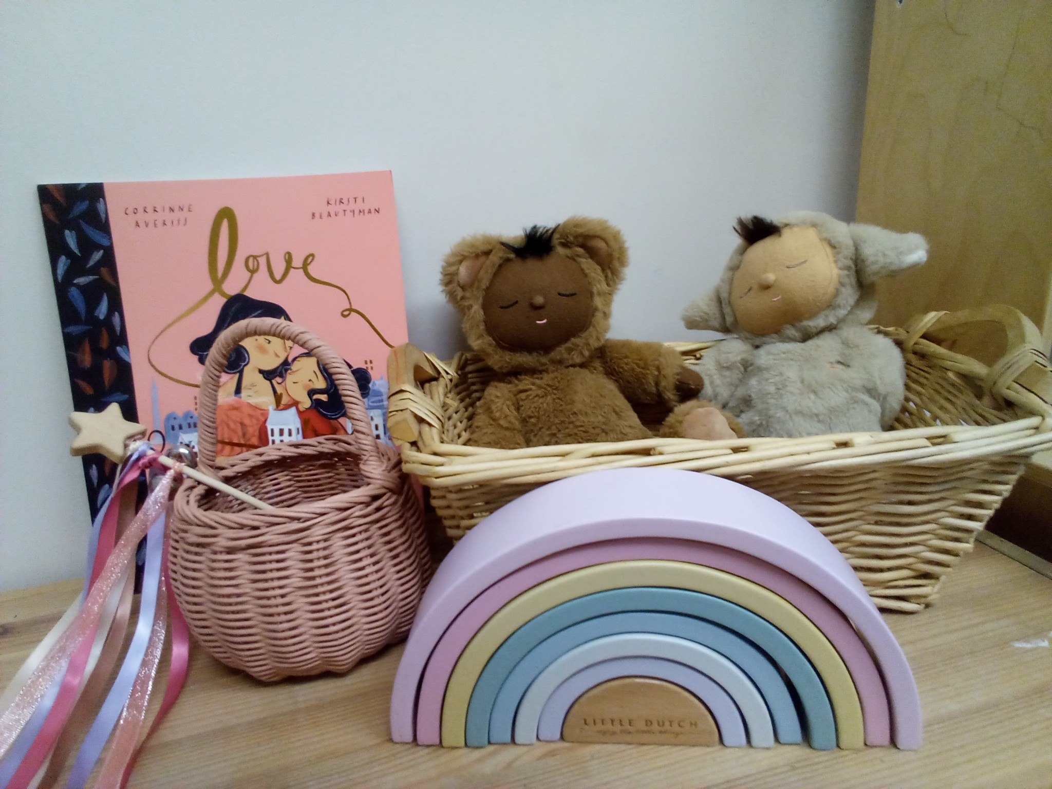
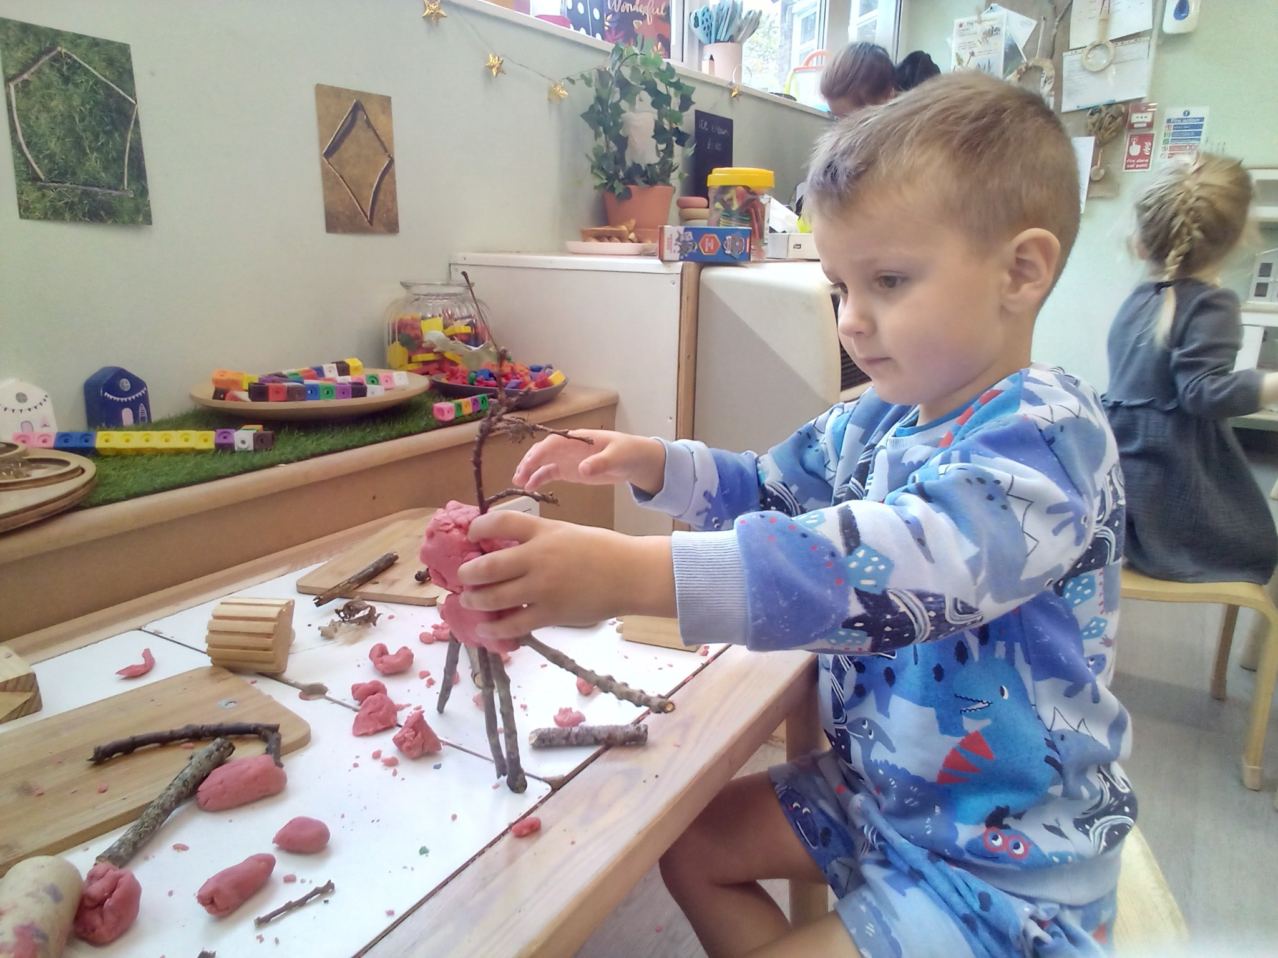
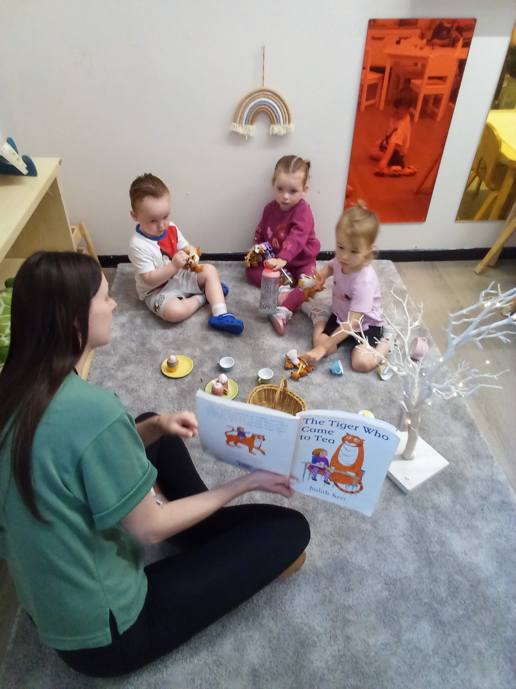
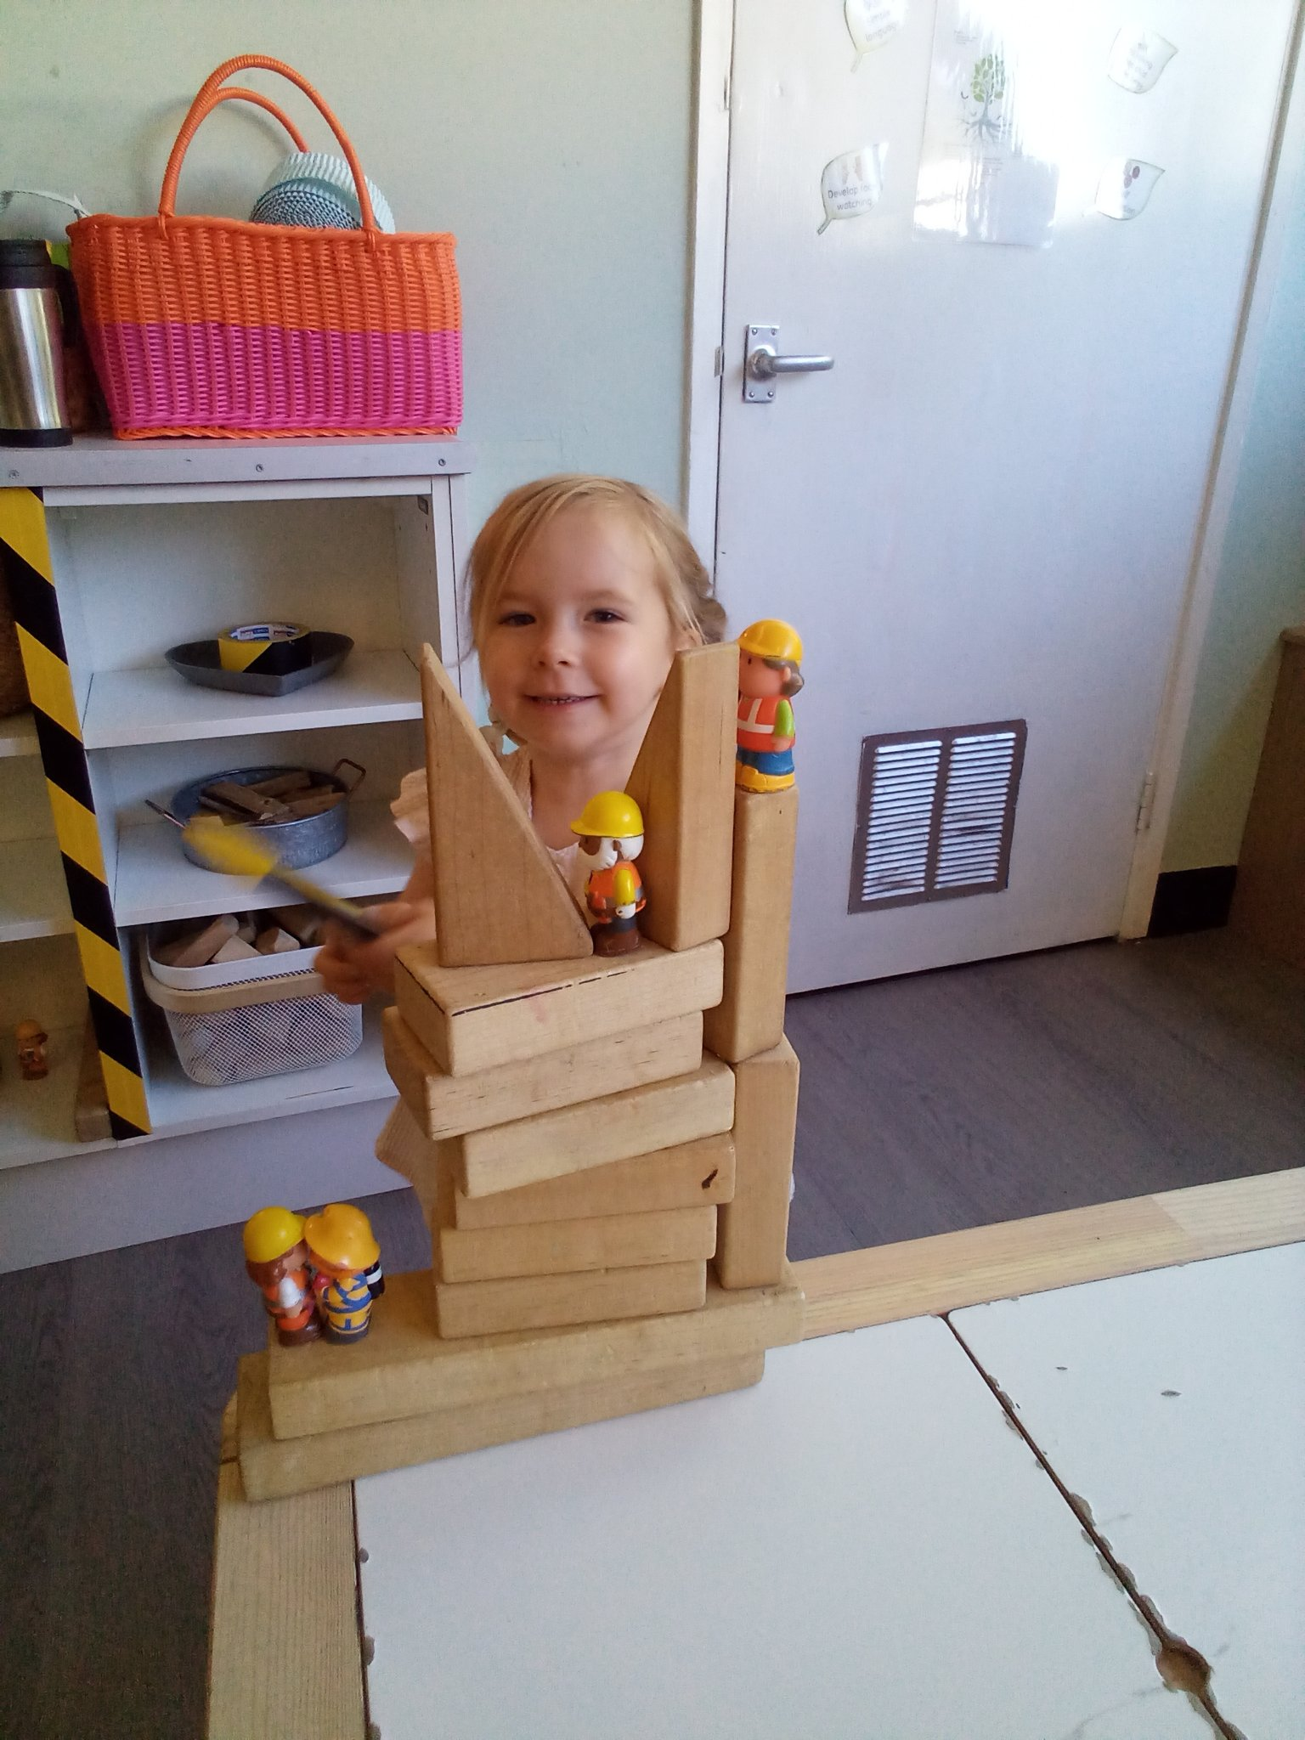
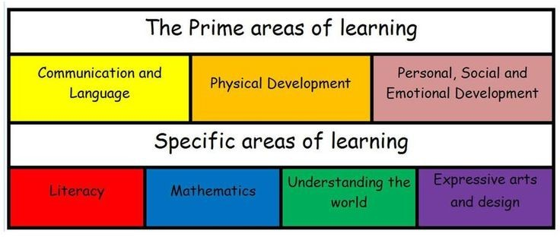
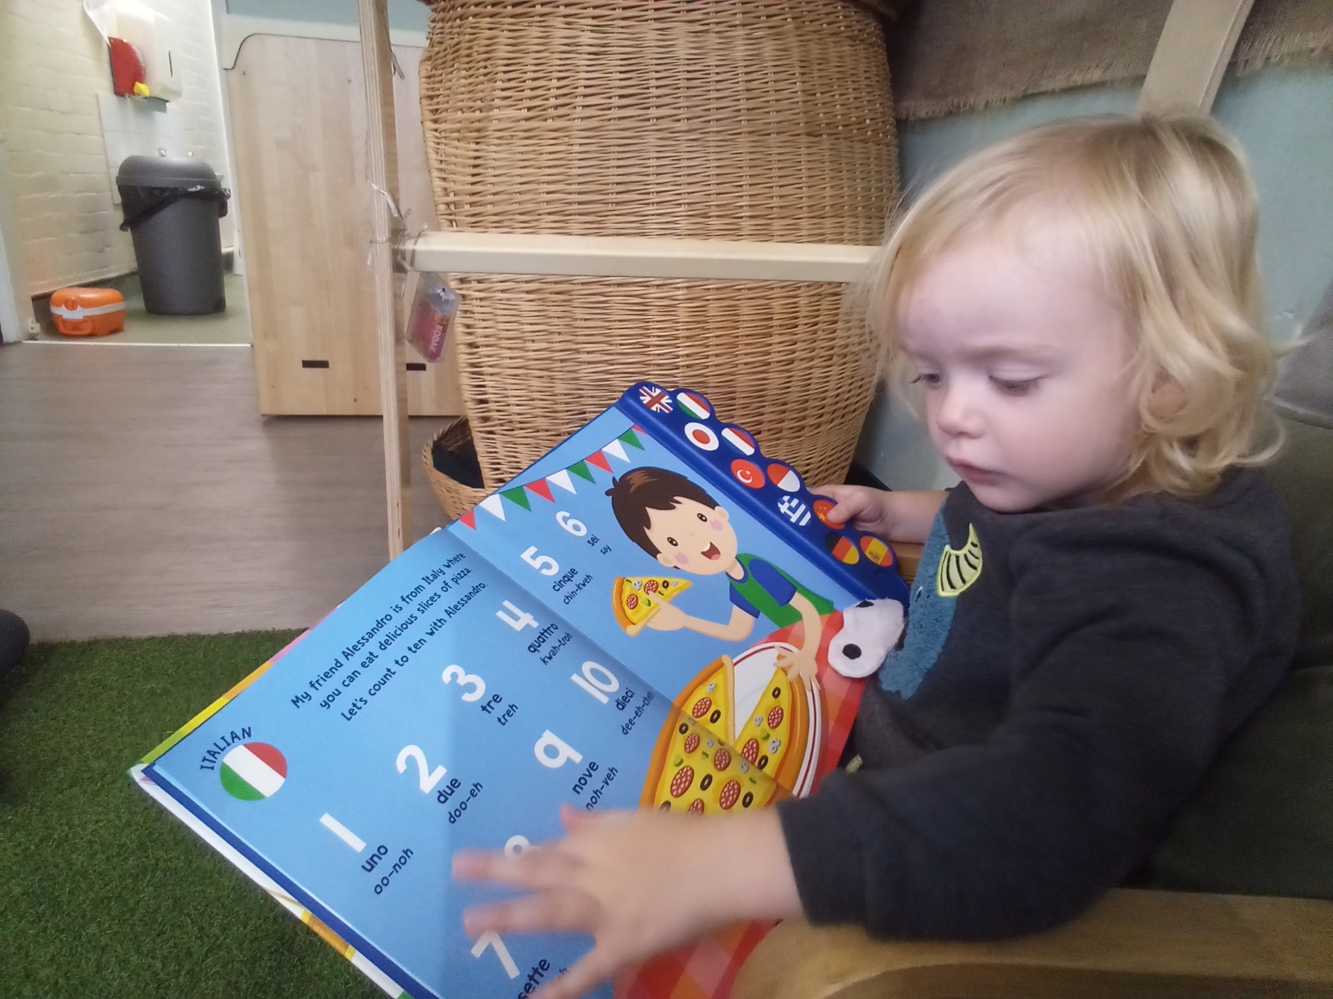
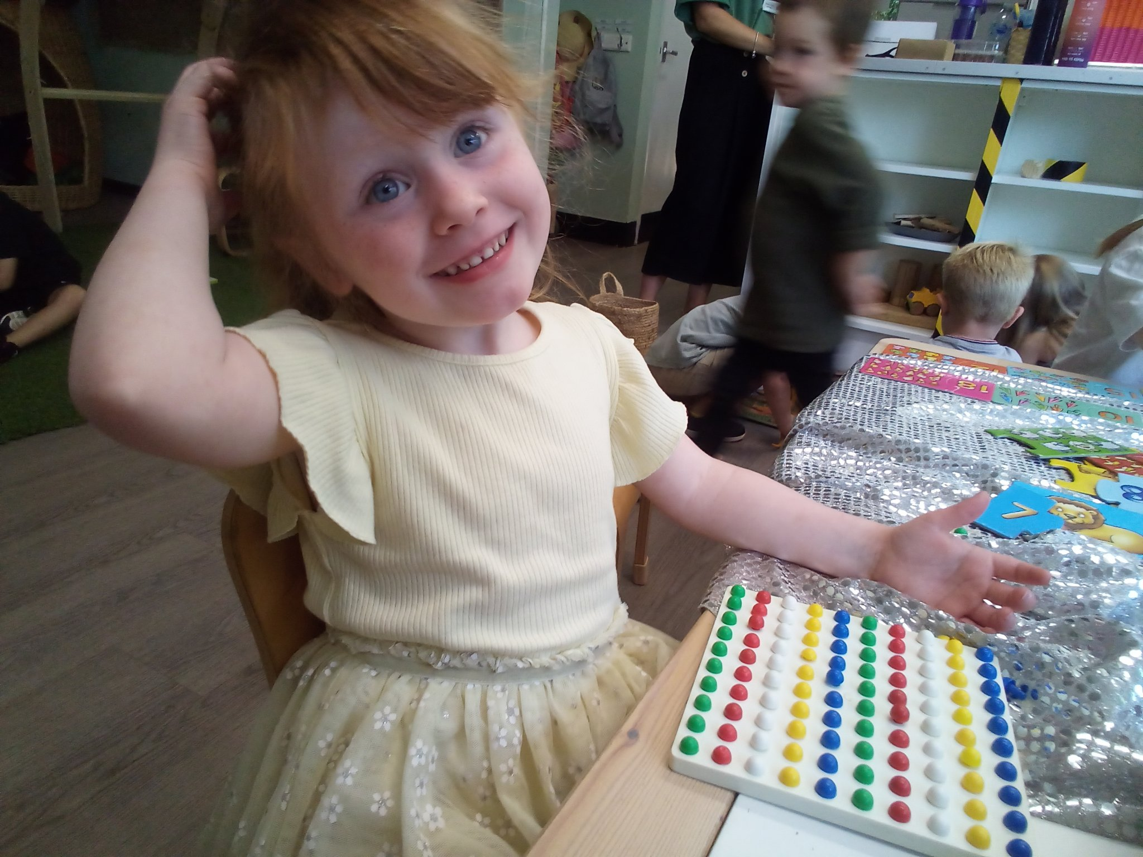
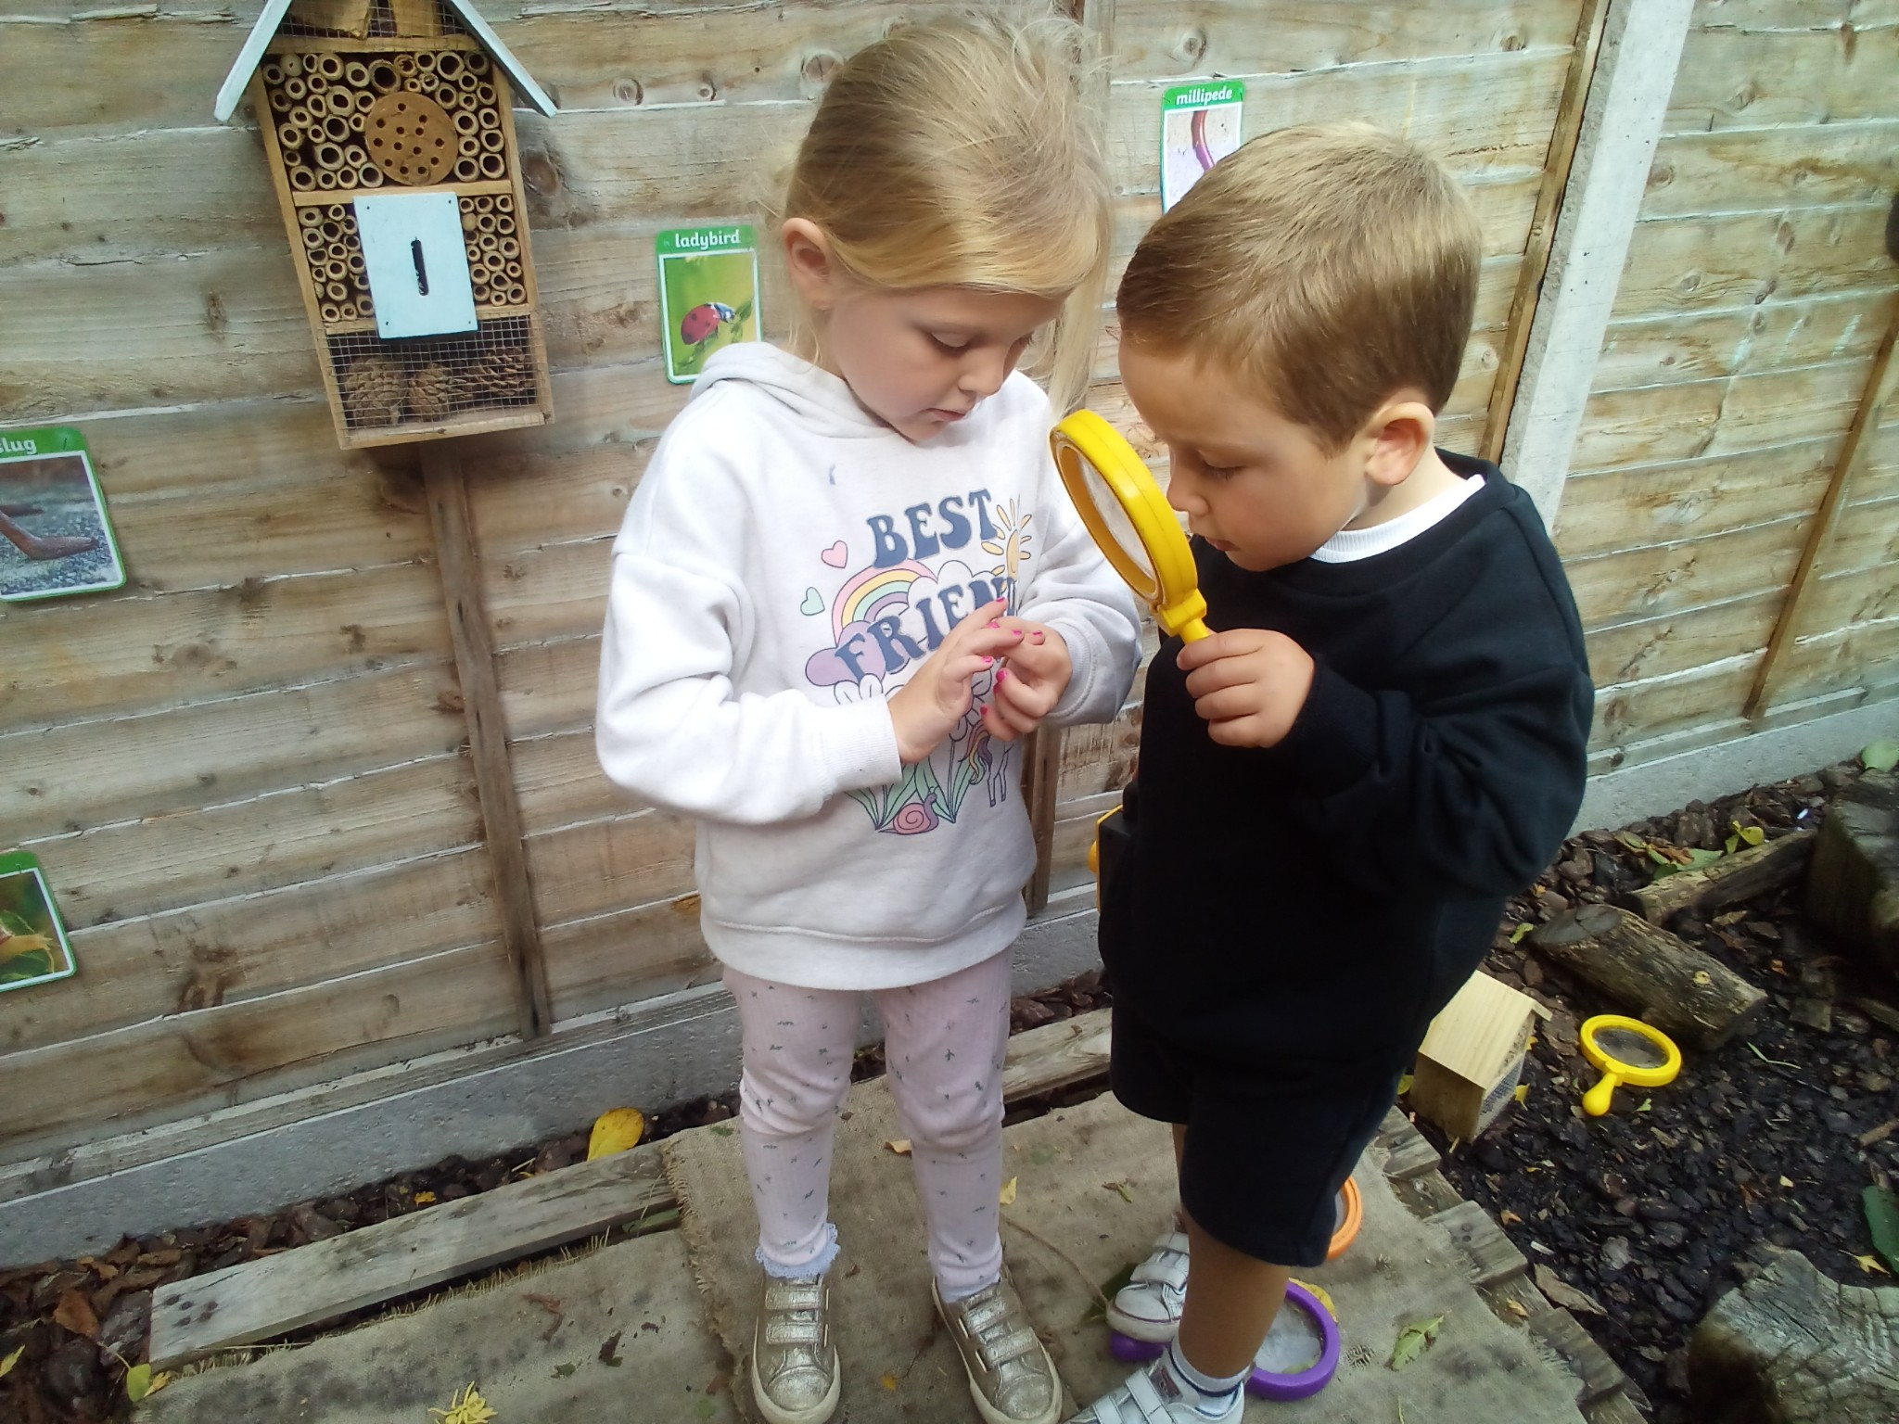
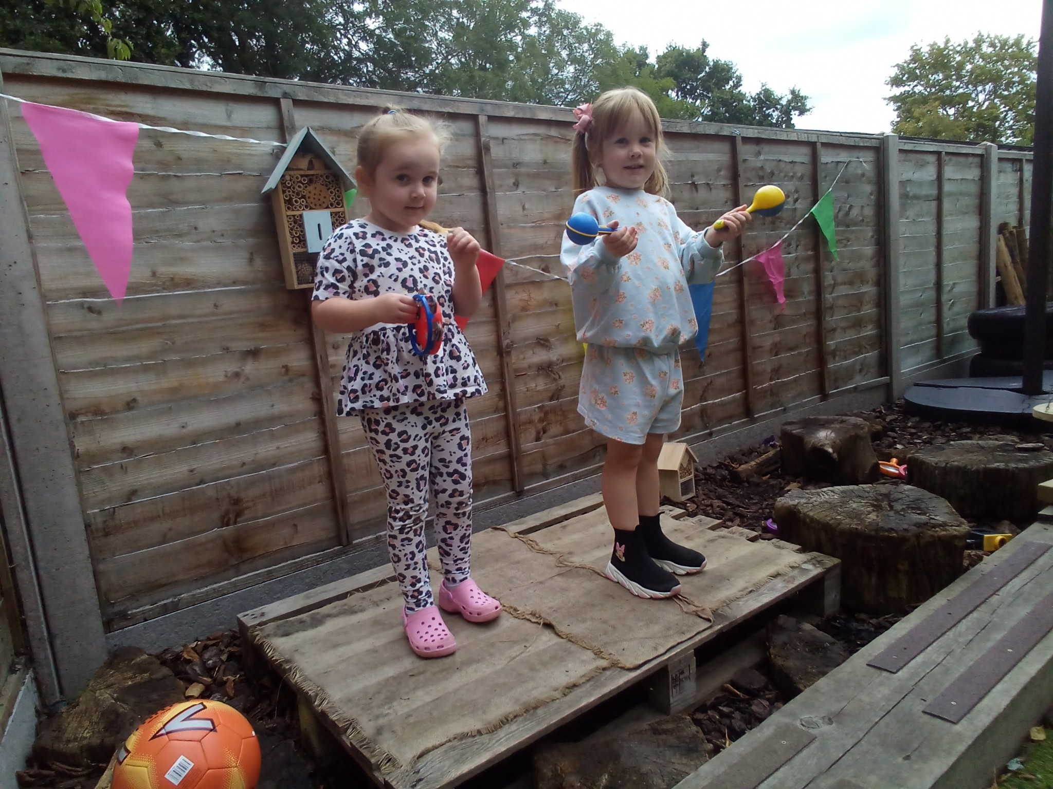

Slide 8
Early Years Foundation Stage (EYFS)
At Young Risers we follow the EYFS curriculum. Below is an outline of the purpose and aims as described in the EYFS statutory framework
Purpose and aims (EYFS Statutory Framework)‏
Every child deserves the best possible start in life and the support to fulfil their potential. A child’s experience in the early years has a major impact on their future life chances. A secure, safe and happy childhood is important in its own right and it provides the foundation for children to make the most of their talents as they grow up. When parents choose to use early years services, they want to know that provision will keep their children safe and help support them to thrive. The Early Years Foundation Stage (EYFS) is the framework that provides that assurance.
The overarching aim of the EYFS is to help young children achieve the five Every Child Matters outcomes of staying safe, being healthy, enjoying and achieving, making a positive contribution, and achieving economic well-being by:
setting the standards for the learning, development and care young children should experience when they are attending a setting outside their family home, ensuring that every child makes progress, and that no child gets left behind;
promoting equality of opportunity and anti-discriminatory practice and ensuring that every child is included and not disadvantaged because of ethnicity, culture or religion, home language, family background, learning difficulties or disabilities, gender or ability;
creating the framework for partnership working between parents and professionals, and between all the settings that the child attends;
improving quality and consistency in the early years sector through setting a universal set of standards which apply to all settings, ending the distinction between care and learning in the existing frameworks, and providing the basis for the inspection and regulation regime; and
laying a secure foundation for future learning through learning and development which is planned around the individual needs of the child, and informed by the use of ongoing observational assessment.

Slide 9
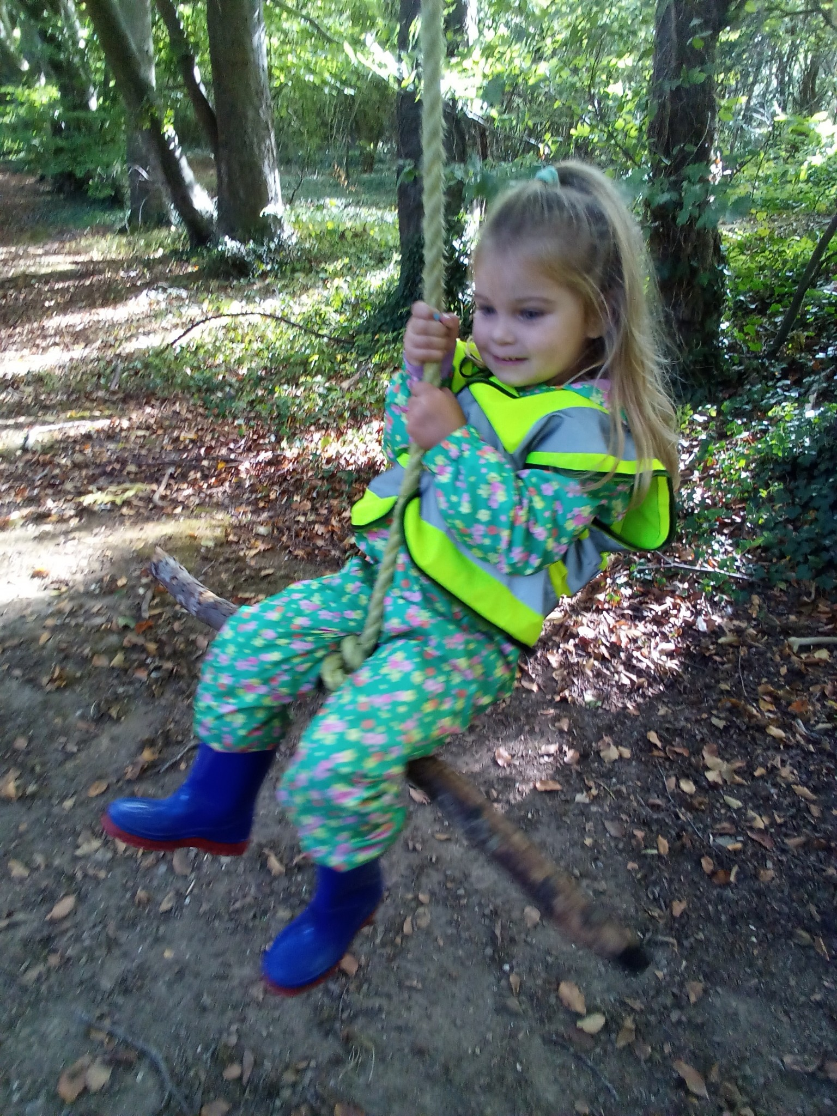
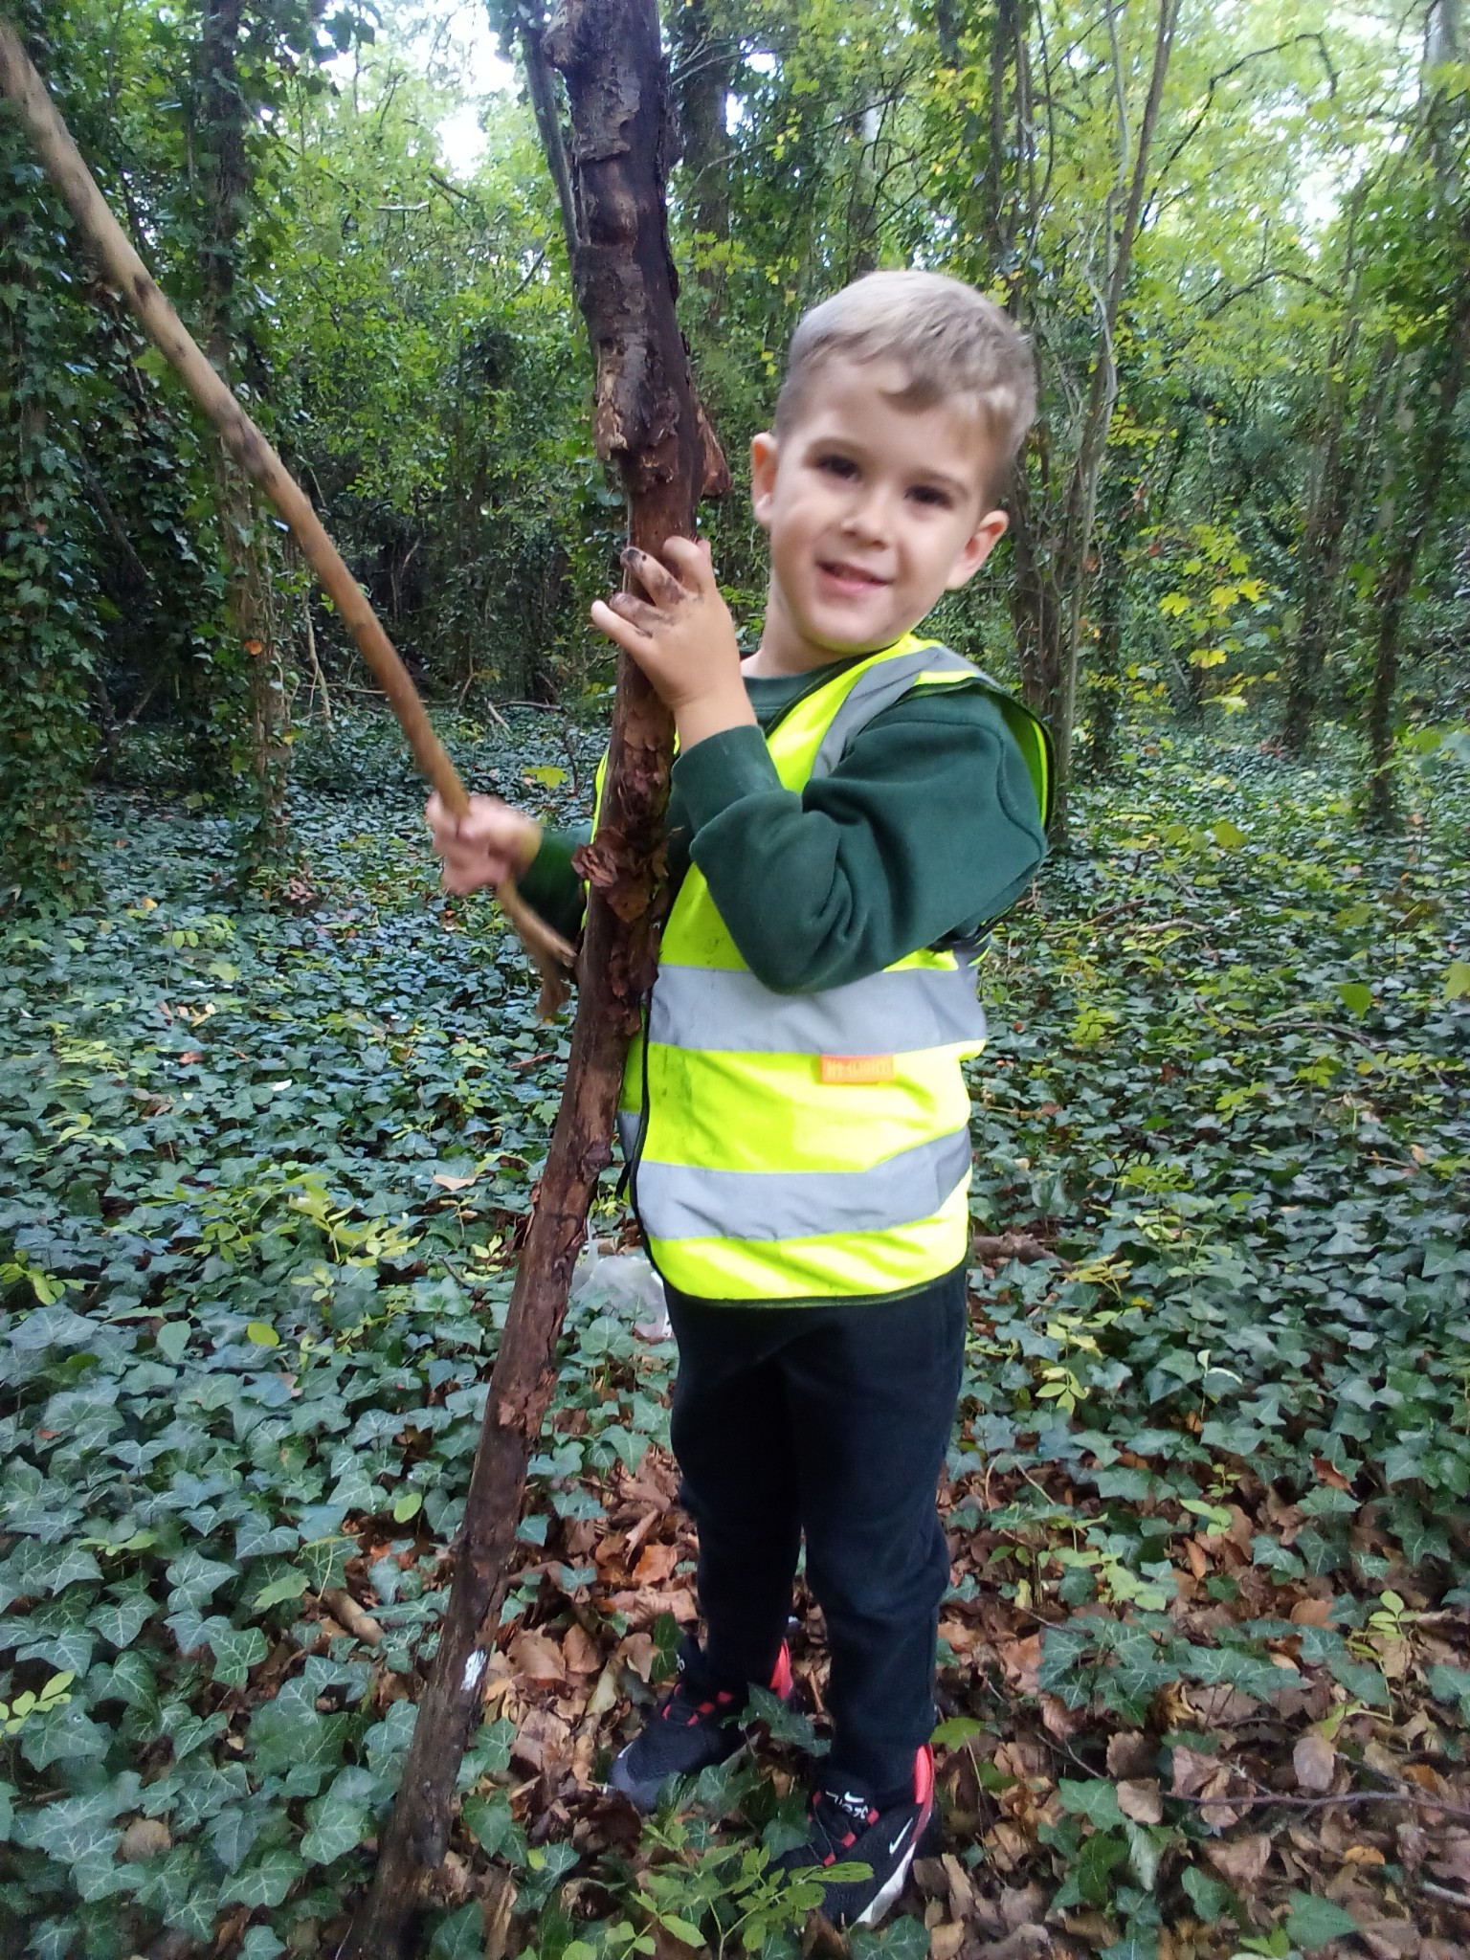
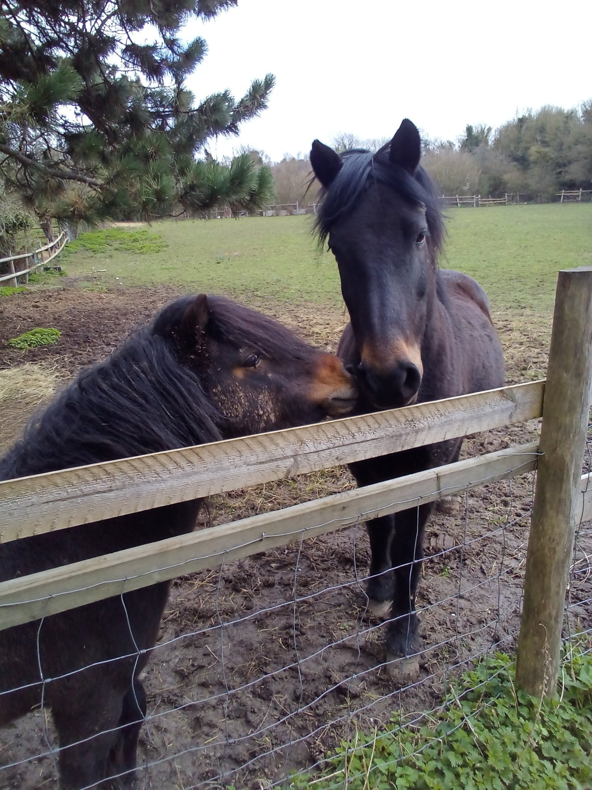
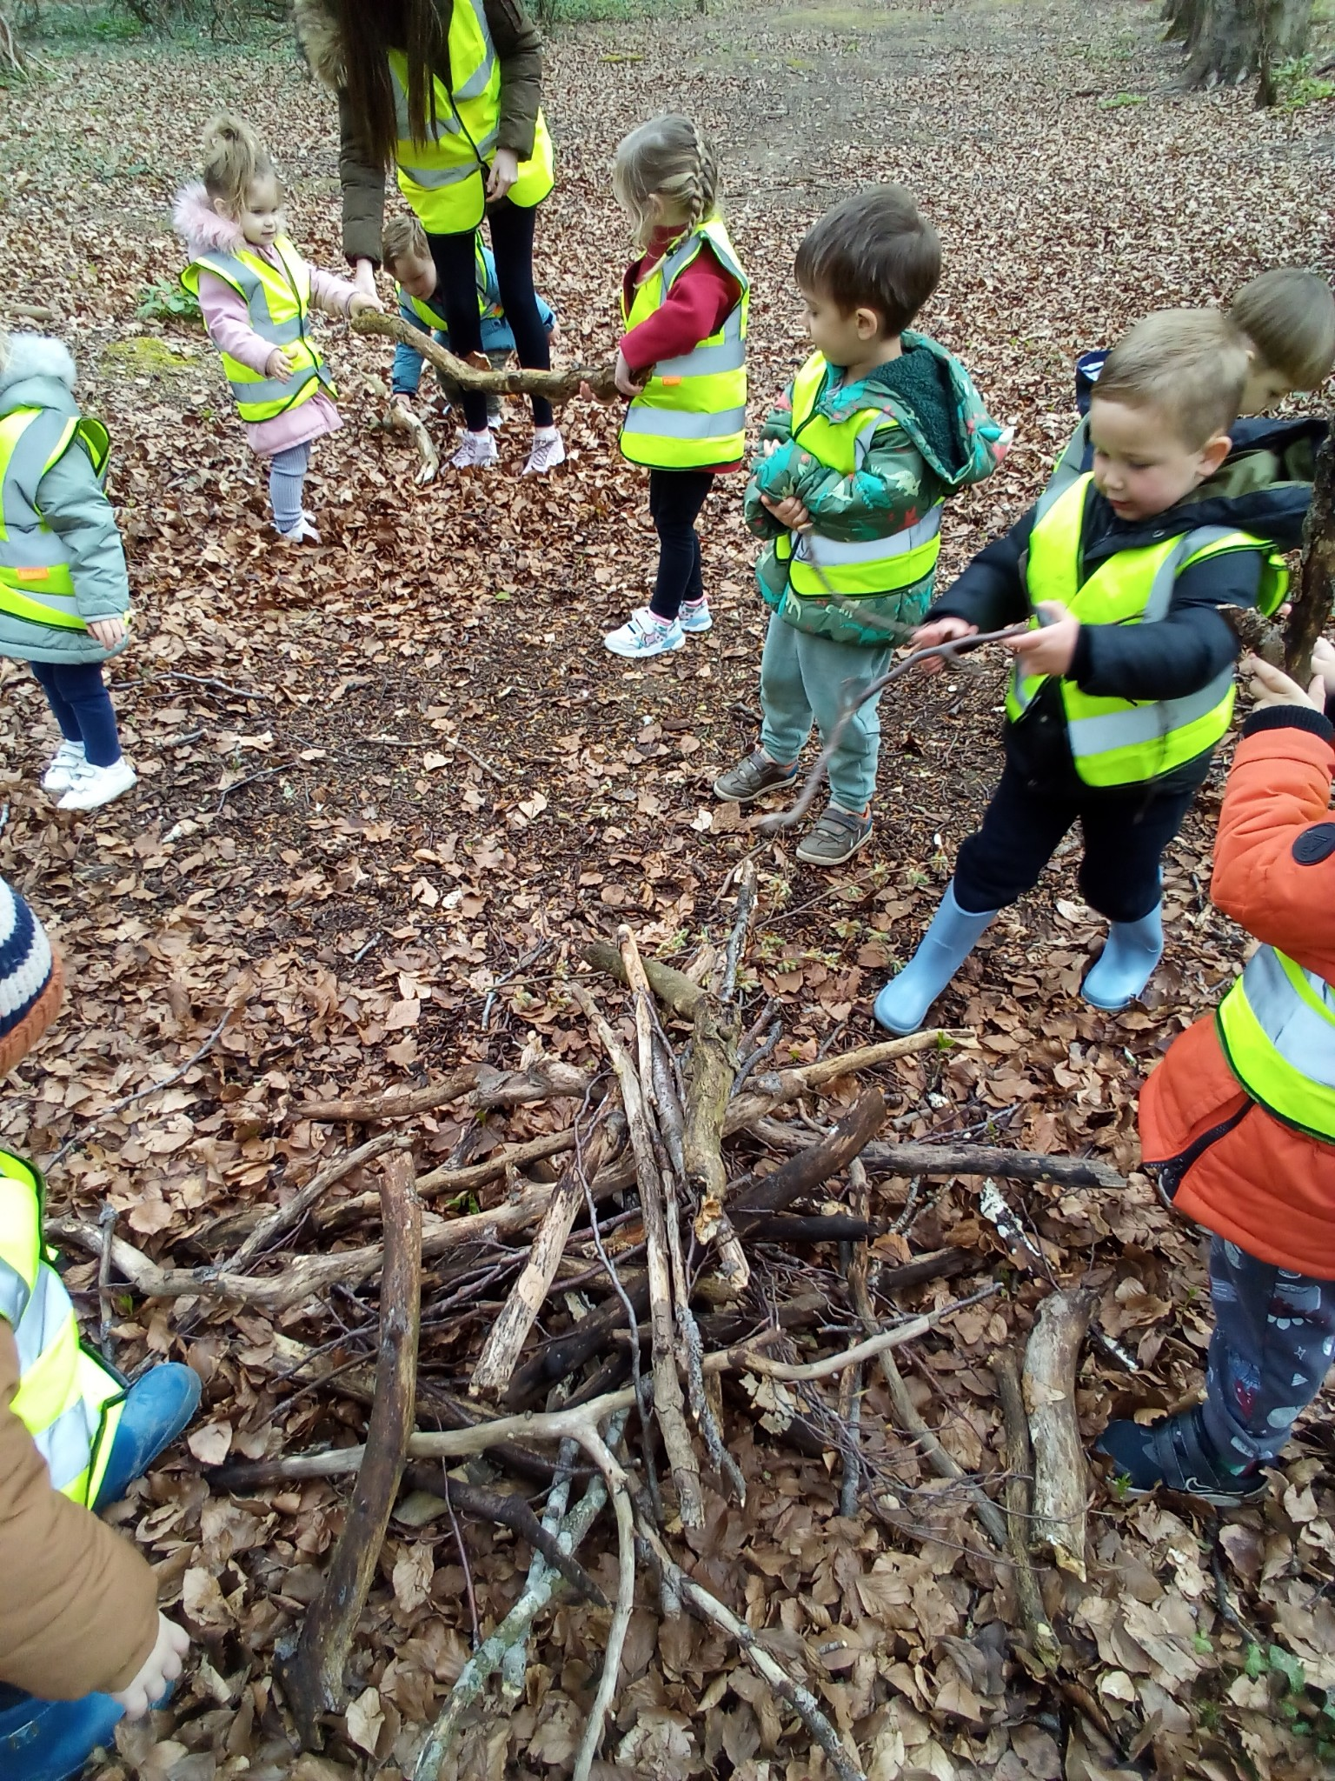
Outdoor Curriculum
The children have free play access to the garden area during the day and it is open in all weathers come rain or shine.
We always ensure that children are dressed appropriately for the weather, and we do provide muddy puddles outdoor wear for the children to wear.
We are very lucky to have use of the school’s field and outdoor areas. The children are encouraged to investigate their natural environment. The children have the opportunity to have a story along with a hot chocolate, do tree rubbings, climb trees and explore in messy play.
Outdoor Trips
We also go on trips to the local woods, the children love to explore the woodland environment and will use their imagination for example make a campfire out of sticks, or throw leaves up into the air or talk about the Gruffalo in the deep dark woods. We also say hello to the horses on the way to the woods.

Slide 10
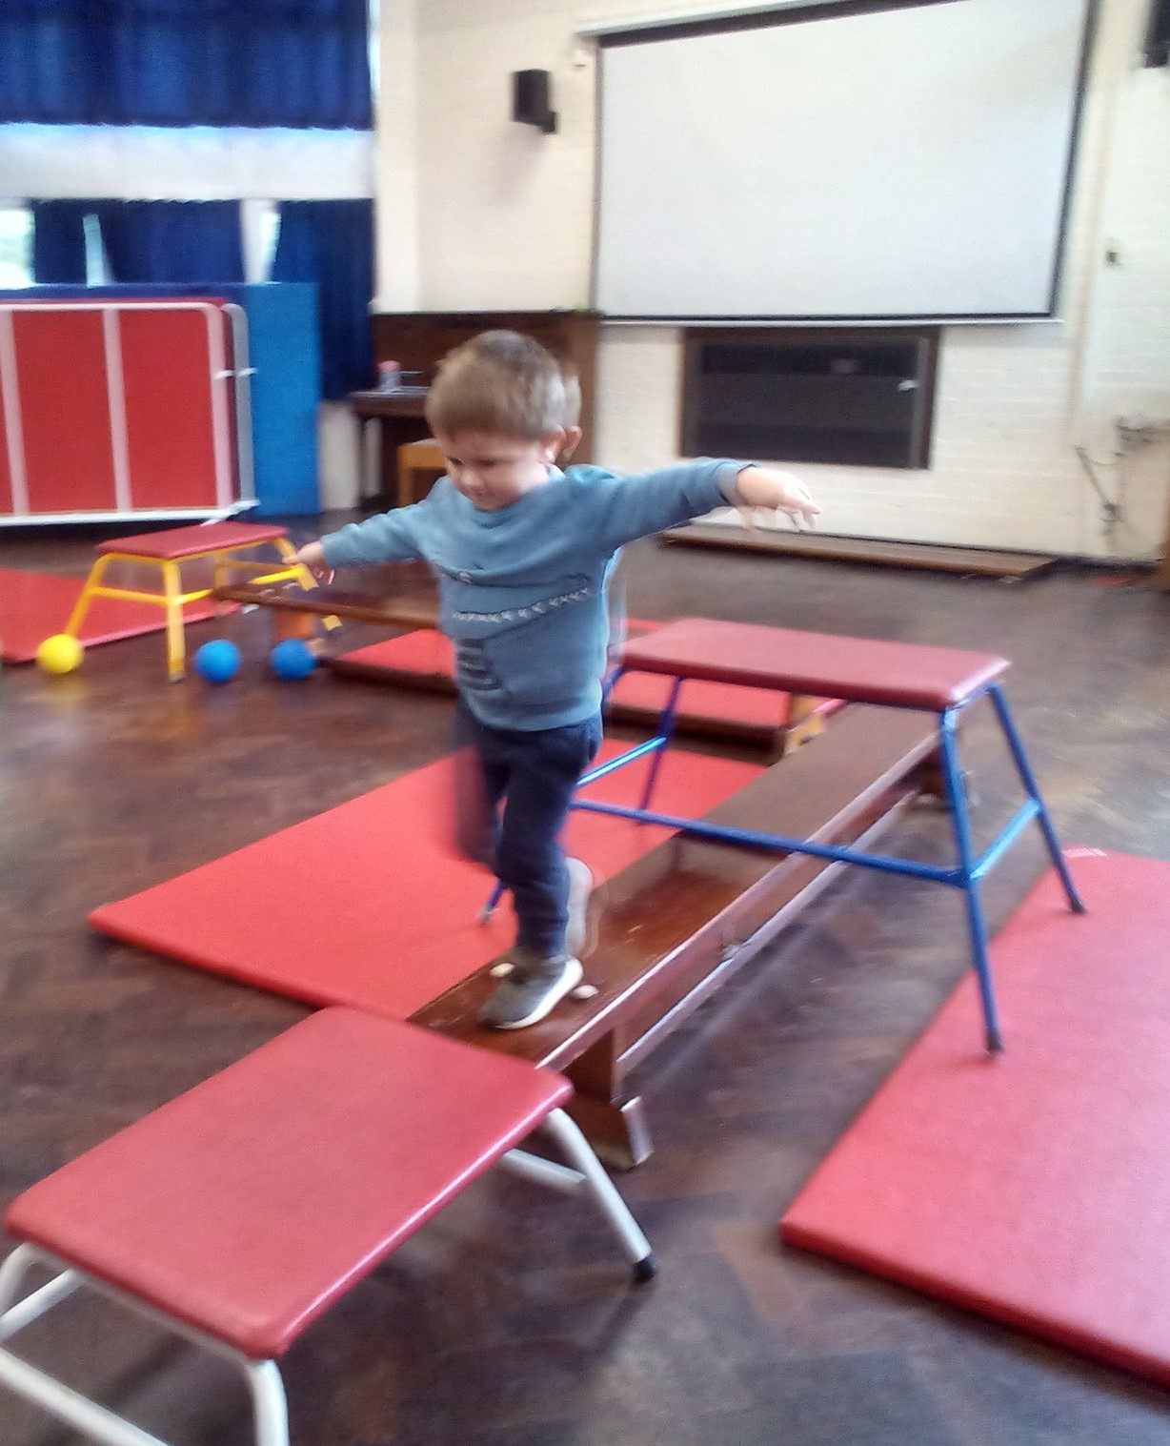
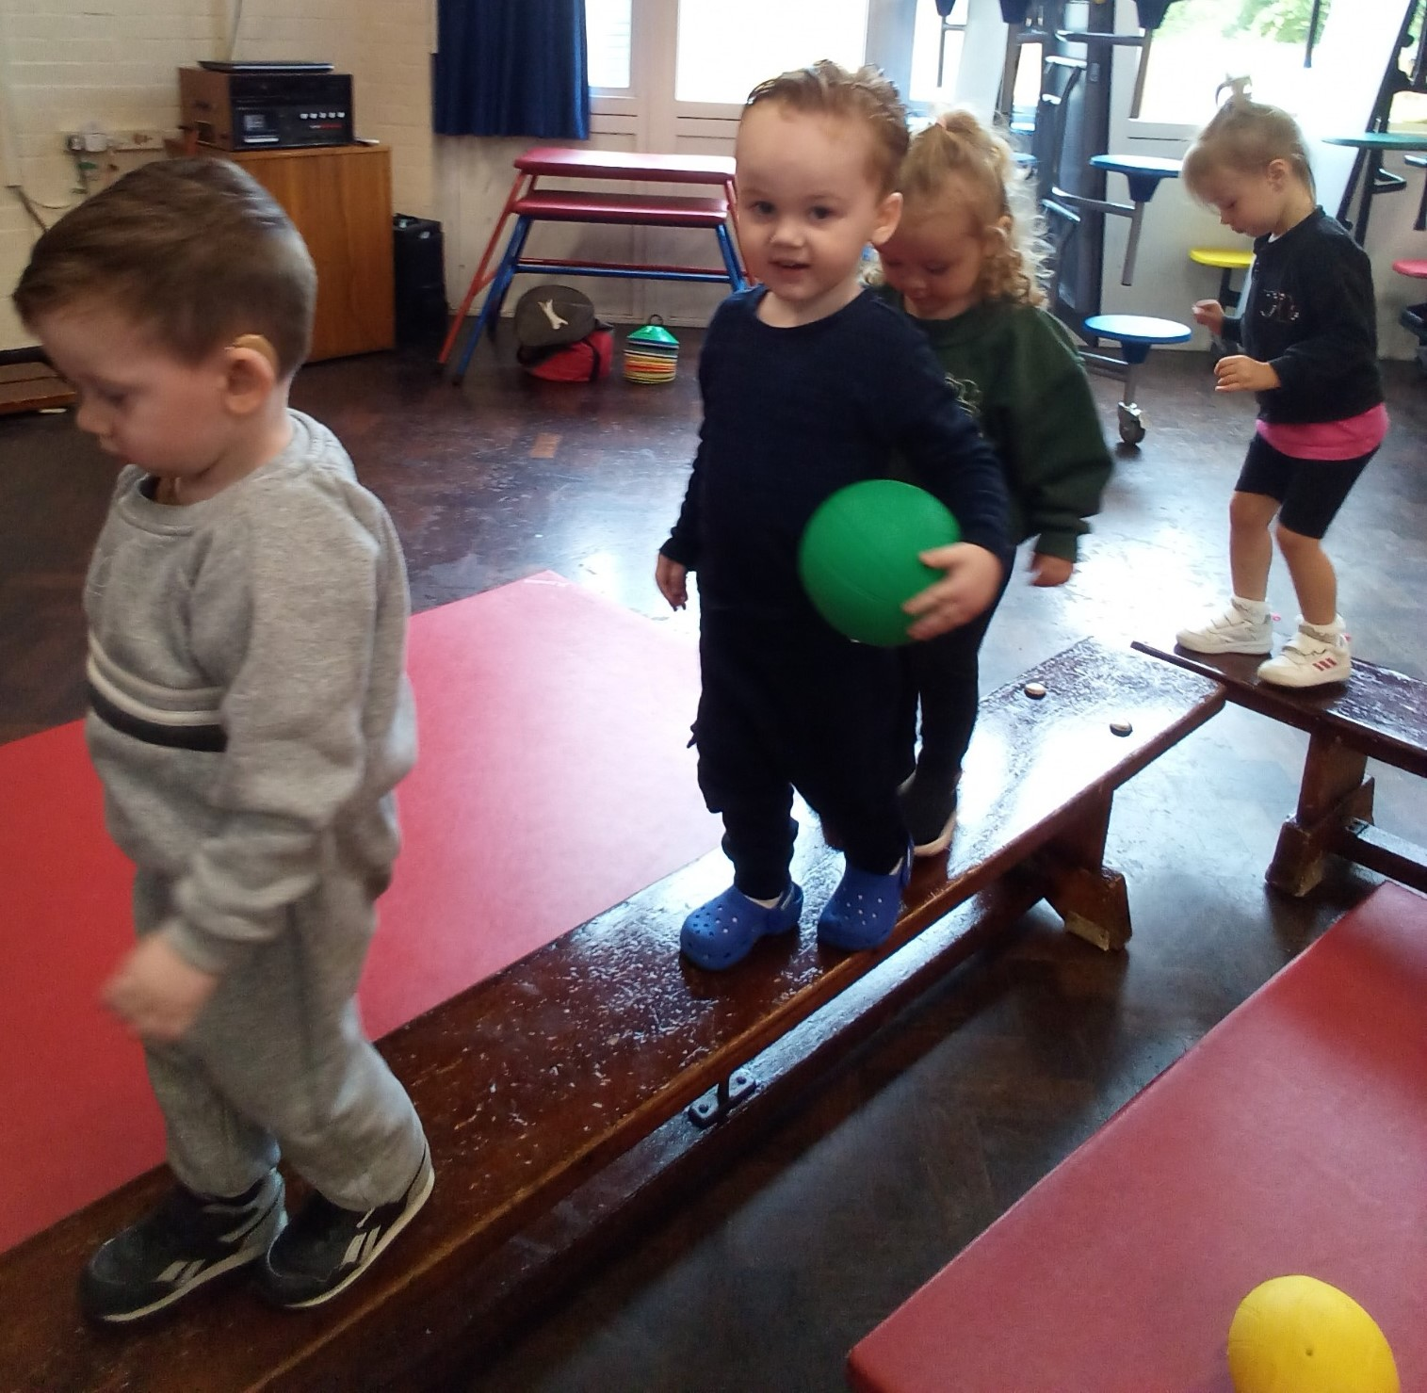
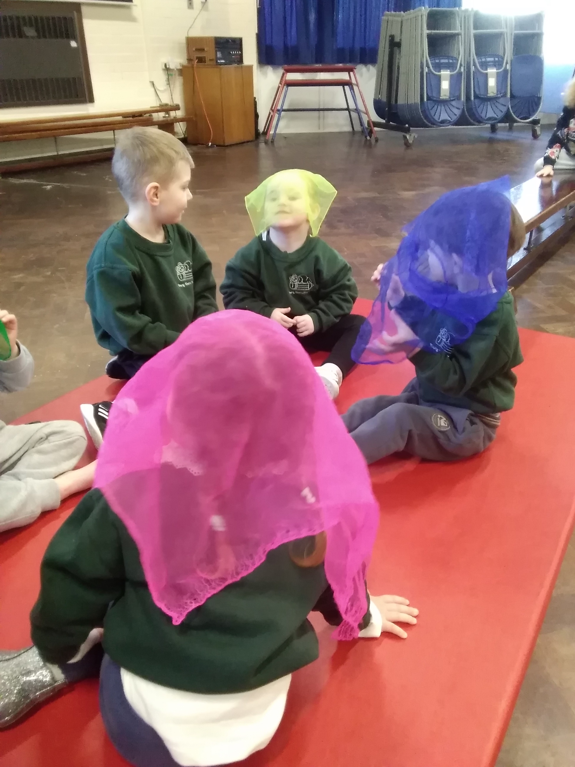
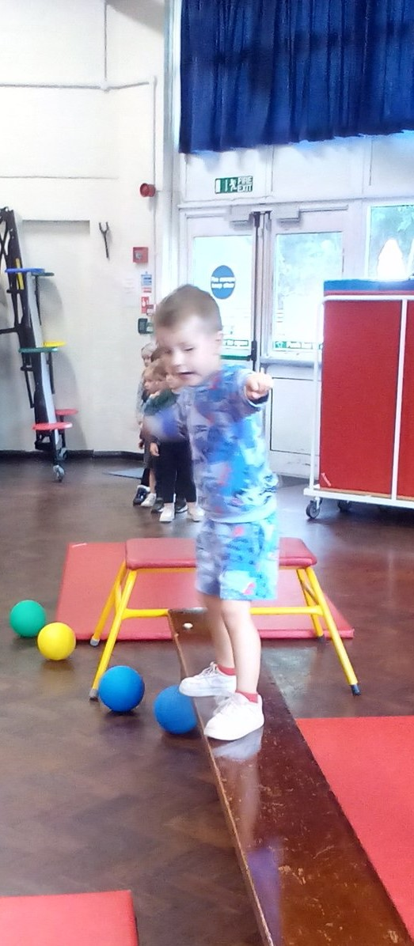
Physical Development - PE
We have access to the school hall a few times each week, the staff and children will do a warm- up session ready to start the planned activity, which could be any one of the following: -
Music and movement to a sticky kids cd, parachute games, ball games, obstacle course, team games and children’s yoga. We then do a cooling down session and work on our breathing ready for the rest of the day.

Slide 11
Parent Involvement
Parents and carers are all invited to be involved in the life of the pre-school. Whether you would like to accompany the children on an outing, support fund-raising activities or volunteer for the committee; it is these contributions that help make Young Risers a success. Speak to a member of staff or the committee to find out how you can get involved.
Equality and Inclusion – Local Offer
Young risers is committed to valuing diversity by providing equal opportunity and anti-discriminatory practice for all children and families.
Young Risers must publish details and be clear and transparent about the SEND (special educational needs and disability) support we have to offer in our setting, and we will make sure this information is available to support parents in choosing the right setting for their child with SEND.
Fees and Funding
All fees are invoiced in the first week of each term (six times per year). The fees must be paid in full by the deadline or a late charge will be incurred, and your child's placement may be withdrawn.
All children aged 3 years old, and a term are entitled to five free sessions (15 hours) free funding.
We also accommodate children wishing to take up the 30 hours free funding or the free for 2, year old funding at Young Risers where families are eligible These free sessions are government funded and our administrator will be able to provide you with the necessary information and forms should you wish to apply for this.
The payment methods we take at Young Risers are as follows: Cash, Childcare Vouchers or direct into Bank Account.

Slide 12
A person’s a person, no matter how small
“
”
Dr Suess

Slide 13
Contact Us
01474 832205
Sarah.leigh@yrps.co.uk
Beckie.francis@yrps.co.uk

